Slide 1
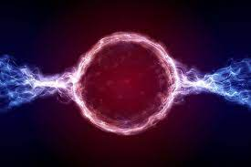
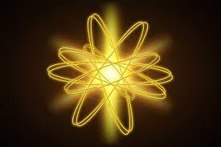
Energy
TEACHER: Clara Cnudde
Materials used for educational purposes

Slide 2
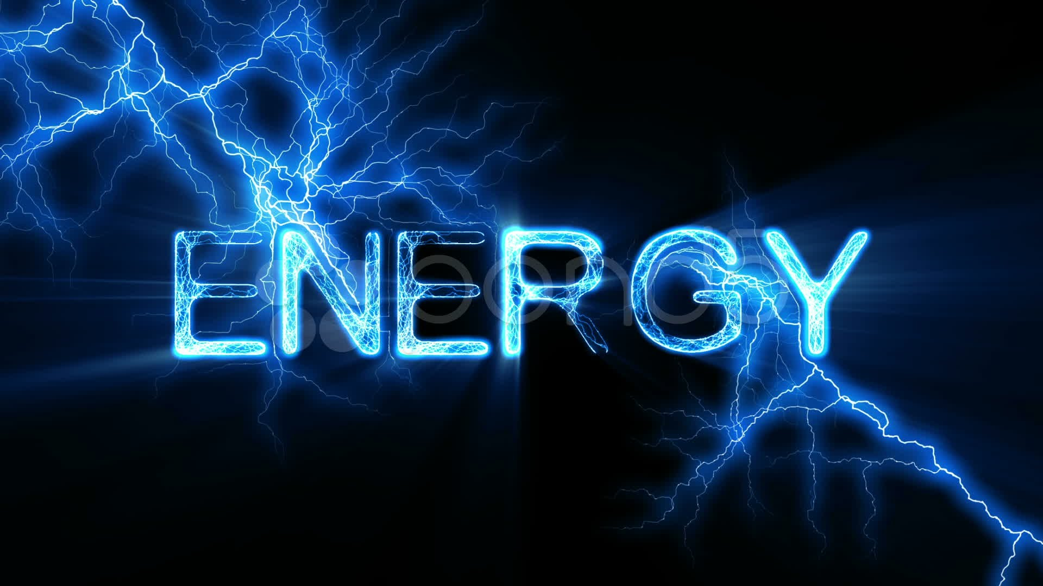

Slide 3
1
Energy, in physics, is the capacity for doing work.
It may exist in potential, kinetic, thermal, electrical, chemical, nuclear, or other various forms.
There are, moreover, heat and work—i.e., energy in the process of transfer from one body to another. After it has been transferred, energy is always designated according to its nature. Hence, heat transferred may become thermal energy, while work done may manifest itself in the form of mechanical energy.
All forms of energy are associated with motion. For example, any given body has kinetic energy if it is in motion. A tensioned device such as a bow or spring, though at rest, has the potential for creating motion; it contains potential energy because of its configuration. Similarly, nuclear energy is potential energy because it results from the configuration of subatomic particles in the nucleus of an atom.
2
3
4
5
6
7
8
motion nature thermal mechanical work transfer at rest potential

Slide 4
Energy, in physics, is the capacity for doing work.
It may exist in potential, kinetic, thermal, electrical, chemical, nuclear, or other various forms.
There are, moreover, heat and work—i.e., energy in the process of transfer from one body to another. After it has been transferred, energy is always designated according to its nature. Hence, heat transferred may become thermal energy, while work done may manifest itself in the form of mechanical energy.
All forms of energy are associated with motion. For example, any given body has kinetic energy if it is in motion. A tensioned device such as a bow or spring, though at rest, has the potential for creating motion; it contains potential energy because of its configuration. Similarly, nuclear energy is potential energy because it results from the configuration of subatomic particles in the nucleus of an atom.

Slide 5
https://www.britannica.com/science/energy

Slide 7
A video about energy:
https://www.youtube.com/watch?v=jhKejoBqiYc

Slide 9
BASIC FORMS OF ENERGY

Slide 10
BASIC FORMS OF ENERGY

Slide 11
Other types of energy include:
1
2
3
4
5
6
7
8

Slide 12
Other types of energy include:

Slide 13
Another video about energy:

Slide 14
https://www.youtube.com/watch?v=Q4M-q8fiJ2I&t=32s

Slide 16
3
1
4
2
5
6

Slide 18
What are the examples given in the video for the different types of energy ?

Slide 19
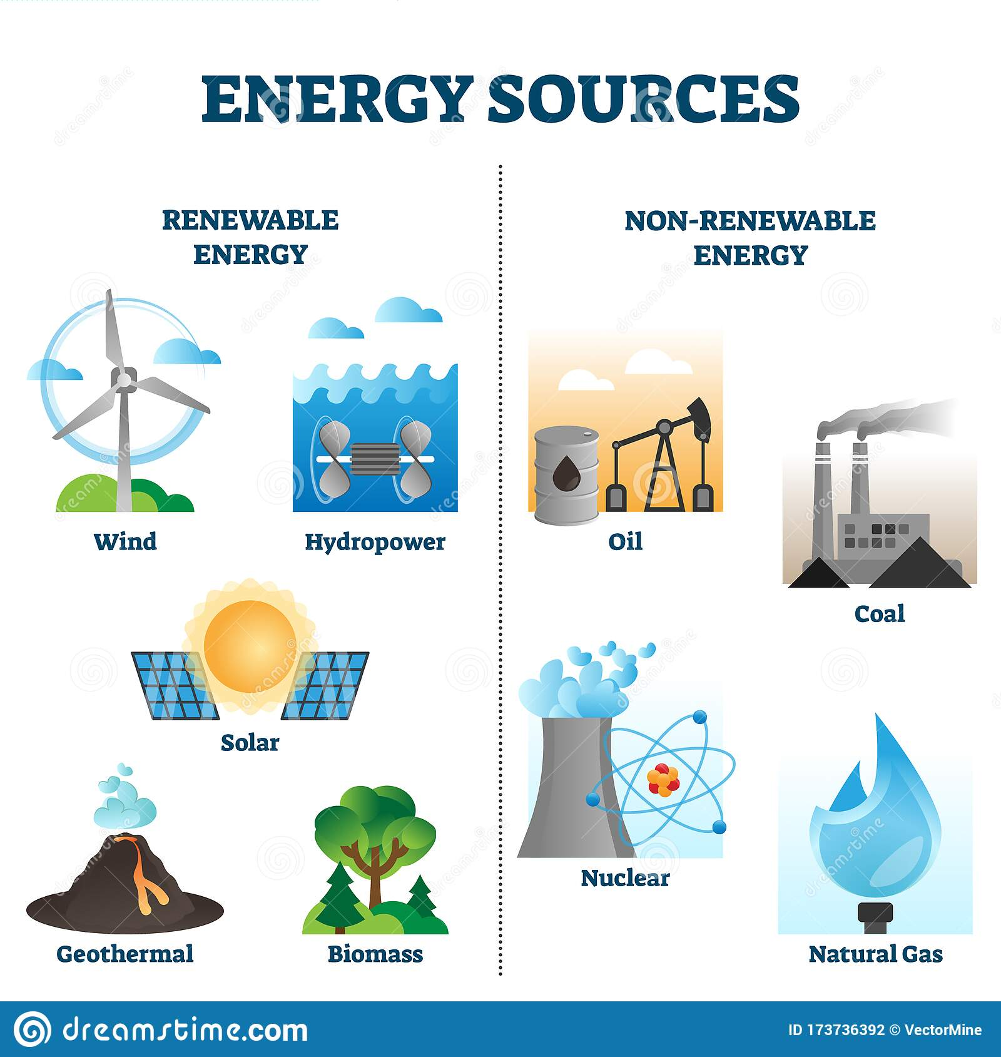

Slide 21
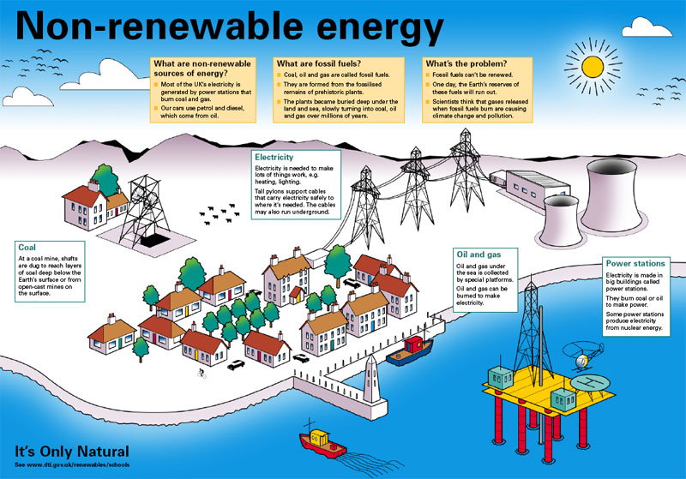

Slide 23
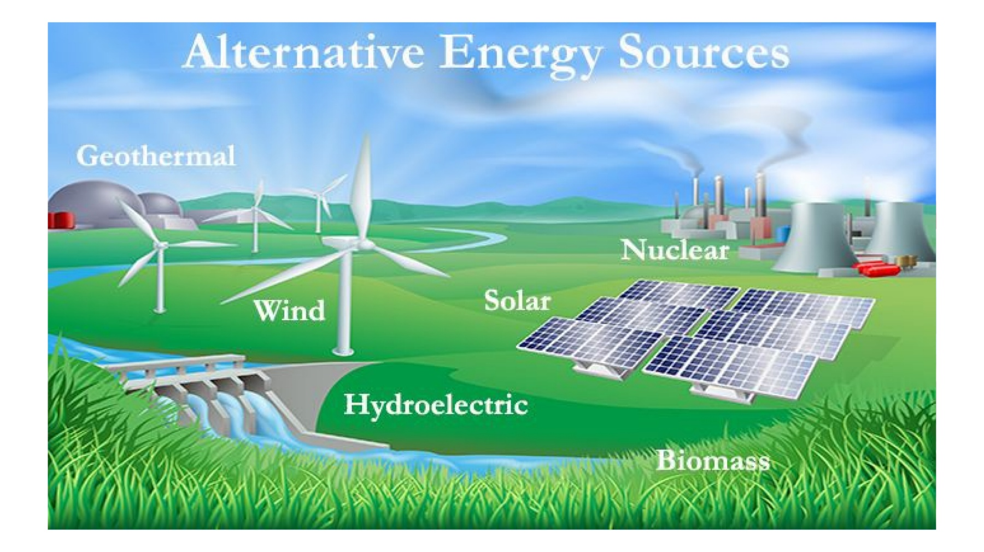
What Are the 9 Most Commonly Used Alternative Energy Sources?
Wind Energy. ...
Solar Energy. ...
Hydroelectric Energy. ...
Geothermal Energy. ...
Bioenergy. ...
Nuclear Energy. ...
Hydrogen Energy. ...
Tidal Energy.

