Slide 1
METAL MANUFACTURING PROCESSES
Engineering materials
TEACHER: Clara Cnudde
Materials used for educational purposes

Slide 2
CASTING
Metal casting is the process of making objects by pouring molten metal into an empty shaped space. The metal then cools and hardens into the form given to it by this shaped mold. Casting is often a less expensive way to manufacture a piece compared with machining the part out of a piece of solid metal.

Slide 3
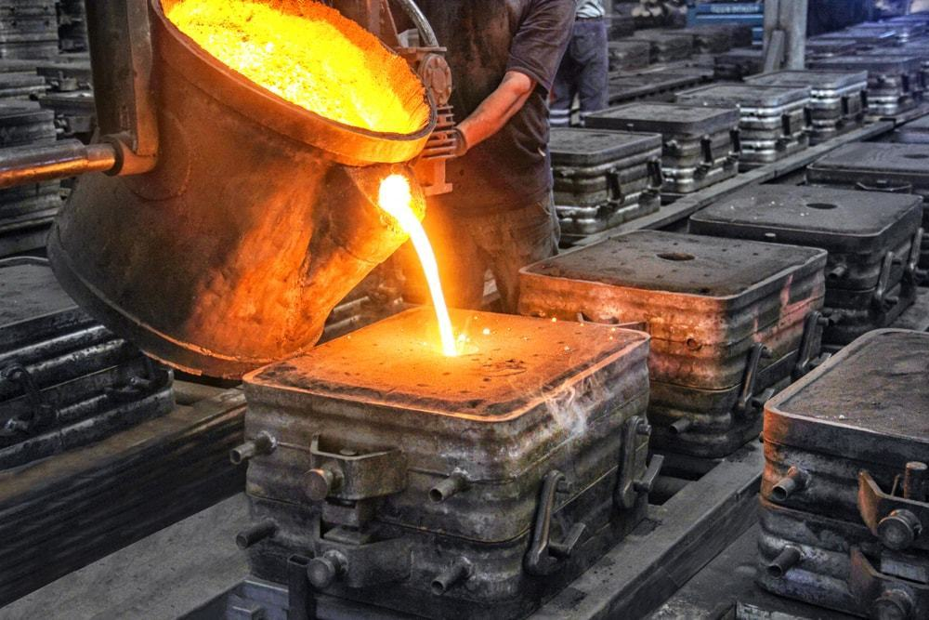
CASTING

Slide 4
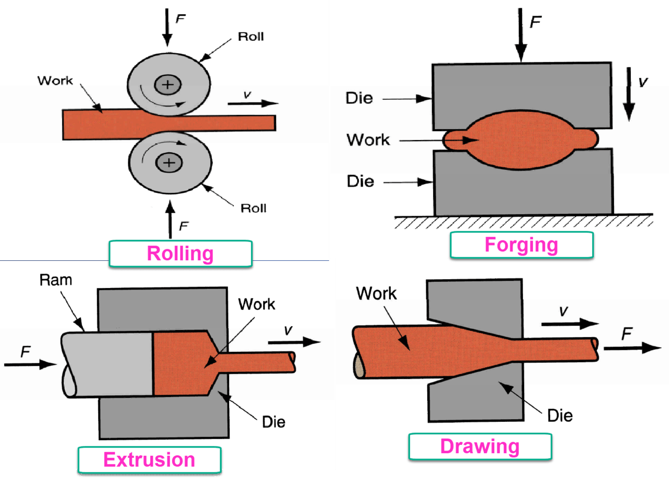
Processes. Metals are important largely because they can be easily deformed into useful shapes. Literally hundreds of metalworking processes have been developed for specific applications, but these can be divided into five broad groups: rolling,
extrusion,
drawing,
forging,
and sheet-metal forming.

Slide 5
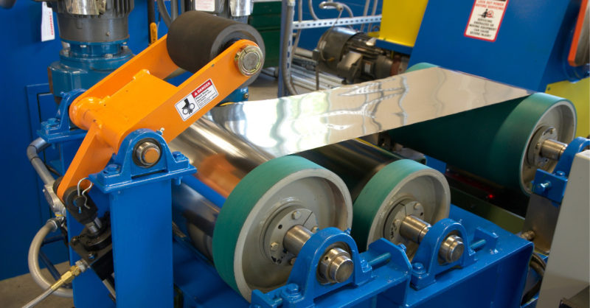
The rolling process is a metal forming process, in which stock of the material is passed between one or more pairs of rollers in order to reduce and to maintain the uniform thickness. This process is mainly focused on the cross-section of the ingot or the metal which is forming.

Slide 6
Metal extrusion is a forming process in which we force a metal (either hot or cold) through a die. This imparts the die shape to the extruded metal as it passes through the cavity. The material emerging from the die is known as “extrudate”.

Slide 7
Drawing is a common metalworking process performed by manufacturing companies. It's able to extend the length of metal by pulling and stretching the metal. It's called “drawing” because the machine “draws” the metal towards it. As the metal stretches, it becomes longer and thinner.

Slide 8
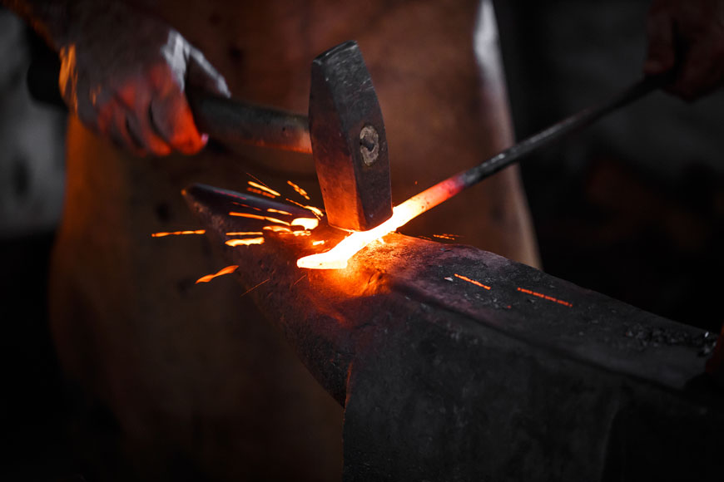
Forging is a manufacturing process involving the shaping of a metal through hammering, pressing, or rolling. These compressive forces are delivered with a hammer or die. Forging is often categorized according to the temperature at which it is performed—cold, warm, or hot forging.

Slide 9
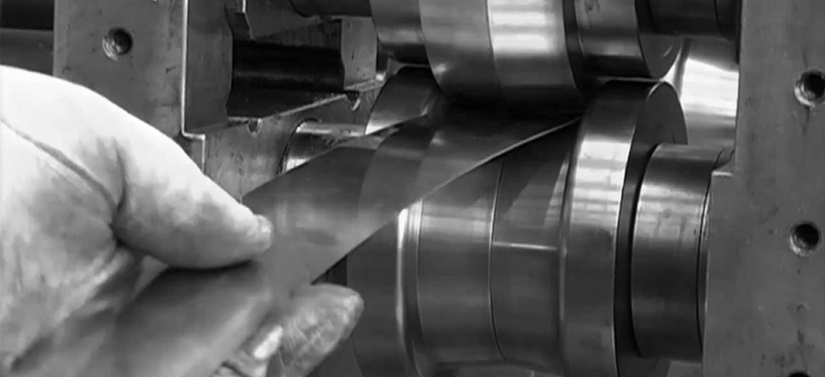
Sheet metal forming is a process where pieces of sheet metal are modified to its geometry rather than removing any materials. The applied process generates a force that stresses the material to deform. This in turn gives the possibility to bend or stretch the sheet to a variety of complex shapes

Slide 11
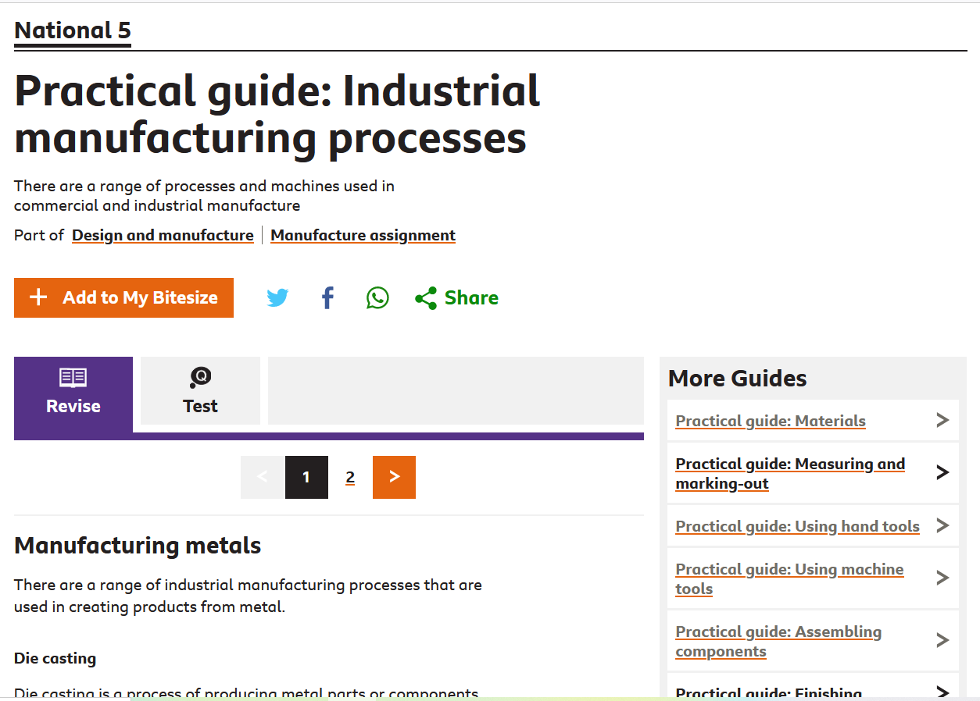
https://www.bbc.co.uk/bitesize/guides/zfp7nrd/revision/1

