Slide 1
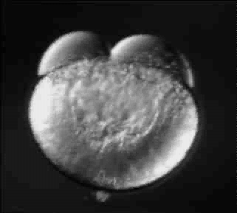
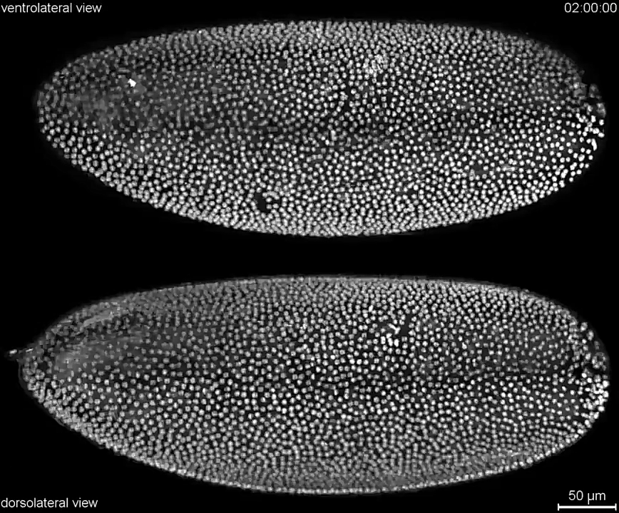


Etapas iniciales del desarrollo
en animales
Flavio Zolessi
fzolessi@fcien.edu.uy
https://youtu.be/PGxkBluFiyA

Slide 2
De una a miles de células

Slide 3
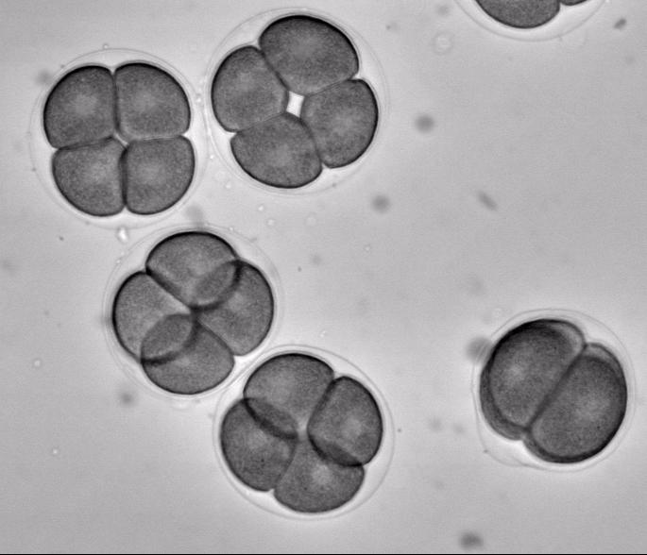
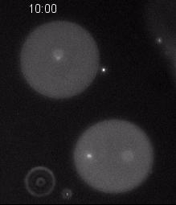
Clivaje en equinodermos
Nicolas Minc

Slide 4
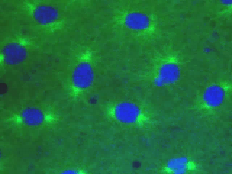
Clivaje en insectos
https://youtu.be/ERnzwtj4YPs
ADN
Microtúbulos
Divisiones sincrónicas y rápidas en un embrión temprano
de la mosca Drosophila melanogaster

Slide 5
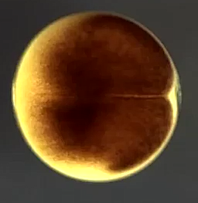
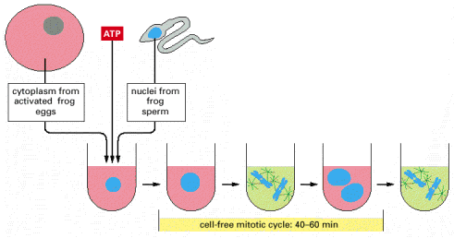
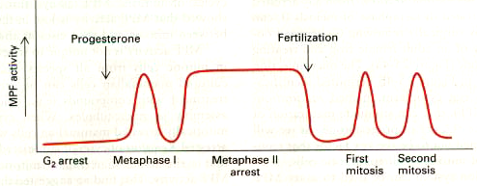
Embriones de Xenopus: purificación de la actividad MPF
(“factor promotor de la mitosis”)
Ensayo libre
de células
1 mm
https://youtu.be/UPJJwVNzaHw
Requiere síntesis de proteínas
Notes:
Figure 13-5. In vitro maturation of Xenopus oocytes and assay of maturation-promoting factor (MPF). (a) Treatment of G2-arrested Xenopus oocytes with progesterone stimulates them to proceed through meiosis I, interphase, and the first half of meiosis II before arresting in the metaphase of meiosis II. Three pairs of duplicated homologous chromosomes (blue) connected to mitotic spindle microtubules (red) are shown schematically to represent metaphase cells. After addition of sperm and fertilization, fertilized eggs complete meiosis II. The resulting haploid egg nucleus fuses with the haploid sperm nucleus to produce a diploid zygote, which undergoes the first of 12 synchronous early embryonic cleavages. (b) When cytoplasm from unfertilized eggs arrested in metaphase of meiosis II is injected into G2-arrested oocytes, the oocytes mature into eggs in the absence of progesterone. This process can be repeated multiple times without further addition of progesterone. [See Y. Masui and C. L. Markert, 1971, J. Exp. Zool. 177:129.]
Figure 17-9. Studying the cell cycle in a cell-free system. A large batch of activated frog eggs is broken open by gentle centrifugation, which also separates the cytoplasm from other cell components. The undiluted cytoplasm is collected, and sperm nuclei are added to it, together with ATP. The sperm nuclei decondense and then go through repeated cycles of DNA replication and mitosis, indicating that the cell-cycle control system is operating in this cell-free cytoplasmic extract.
Figure 13-6. Oscillation of MPF activity during meiotic and mitotic cell cycles of Xenopus oocytes and early frog embryos. Diagrams of the cell structures corresponding to each stage are shown in Figure 13-5a. See text for discussion. [See J. Gerhart et al., 1984, J. Cell Biol. 98:1247; adapted from A. Murray and M. W. Kirschner, 1989,Nature 339:275.]

Slide 6
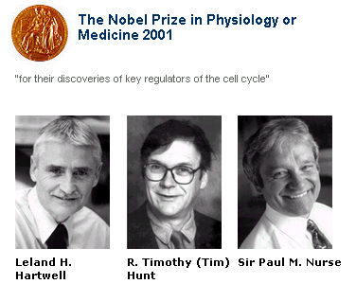
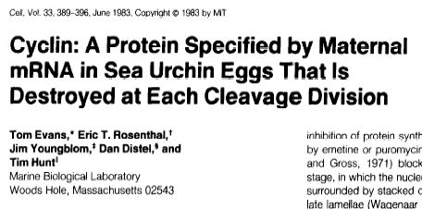
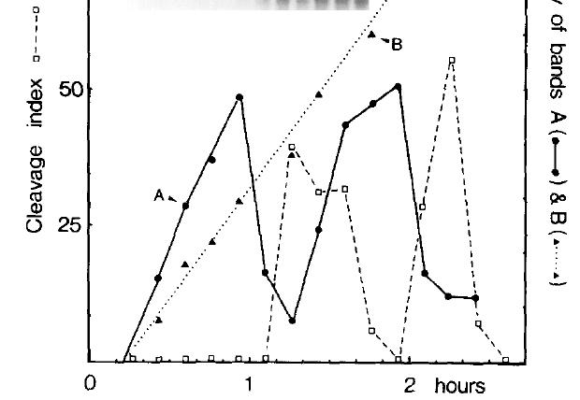
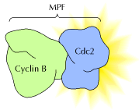
Cdk1
Fig. 2

Slide 7
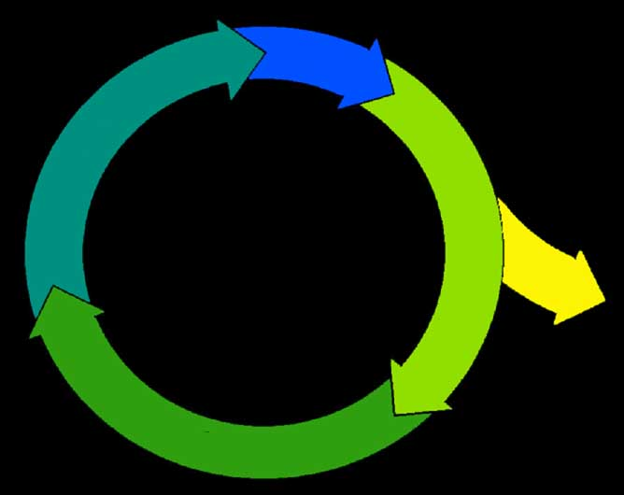
El ciclo celular
M
G2
¿RELOJ
o
DOMINÓ?
G1
R
G0
S

Slide 8
El “reloj”
Interfase
M
Interfase
M

Slide 9
El “dominó”
Ciclina
B
Cdk1
M
Ciclina
D
G2
Cdk4/6
Ciclina
A
Cdk2
G1
R
G0
Ciclina
E
Ciclina
A
Cdk2
Cdk2
S

Slide 10
Establecimiento de ejes embrionarios

Slide 11
https://youtu.be/h9RfeU5u85k

Slide 12
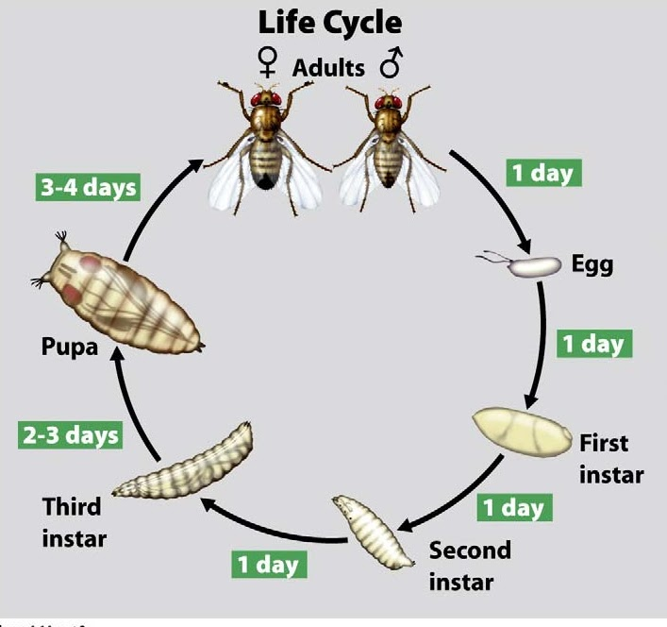

Slide 13
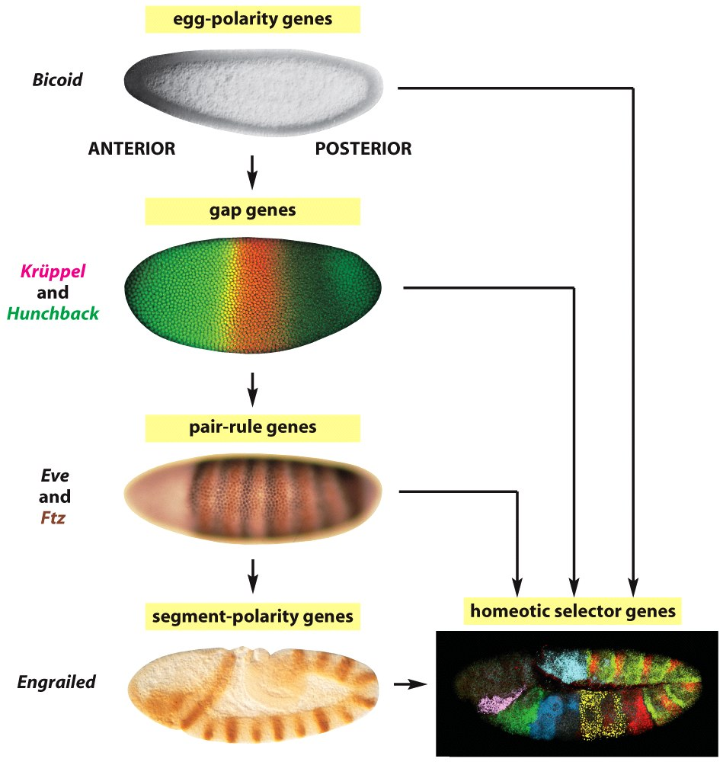
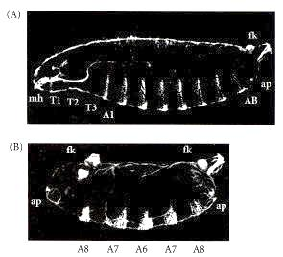
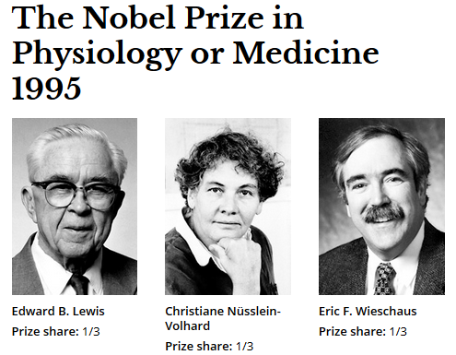
Definición de eje céfalo-caudal en Drosophila
Control
Bicoid -/-
Notes:
Figure 9.12
Phenotype of a strongly affected embryo from a female deficient in the bicoid gene. (A) Wild-type cuticle pattern. (B) Bicoid mutant. The head and thorax have been replaced by a second set of posterior telson structures. Abbreviations: fk, filzkörper; ap, anal plates (both telson structures); T1-T3, thoracic segments; A1, A8, the two terminal abdominal segments; mh, cs, head structures. (From Driever et al. 1990; photographs courtesy of W. Driever.)
From: The Origins of Anterior-Posterior Polarity
Developmental Biology. 6th edition.
Gilbert SF.
Sunderland (MA): Sinauer Associates; 2000.

Slide 14
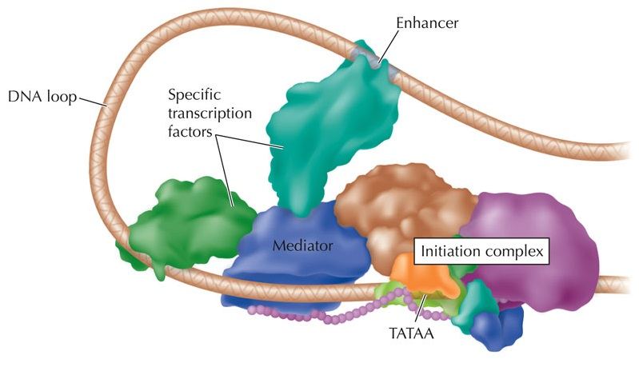
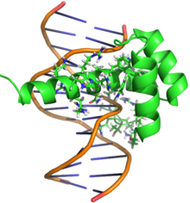
¿Qué es un “factor de transcripción”?
ADN
ARN
Proteína
Bicoid

Slide 15
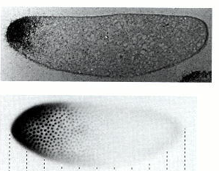
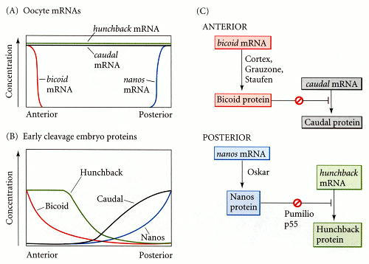
Definición del eje céfalo-caudal en Drosophila
Notes:
Figure 9.11
A model of anterior-posterior pattern generation by the Drosophila maternal effect genes. (A) The bicoid, nanos, hunchback, and caudal messenger RNAs are placed in the oocyte by the ovarian nurse cells. The bicoid message is sequestered anteriorly. The nanos message is sent to the posterior pole. (B) Upon translation, the Bicoid protein gradient extends from anterior to posterior, and the Nanos protein gradient extends from posterior to anterior. Nanos inhibits the translation of the hunchback message (in the posterior), while Bicoid prevents the translation of the caudal message (in the anterior). This inhibition results in opposing Caudal and Hunchback gradients. The Hunchback gradient is secondarily strengthened by the transcription of the hunchback gene in the anterior nuclei (since Bicoid acts as a transcription factor to activate hunchback transcription). (C) Parallel interactions whereby translational gene regulation establishes the anterior-posterior patterning of the Drosophila embryo. (C after Macdonald and Smibert 1996.)
From: The Origins of Anterior-Posterior Polarity
Developmental Biology. 6th edition.
Gilbert SF.
Sunderland (MA): Sinauer Associates; 2000

Slide 16
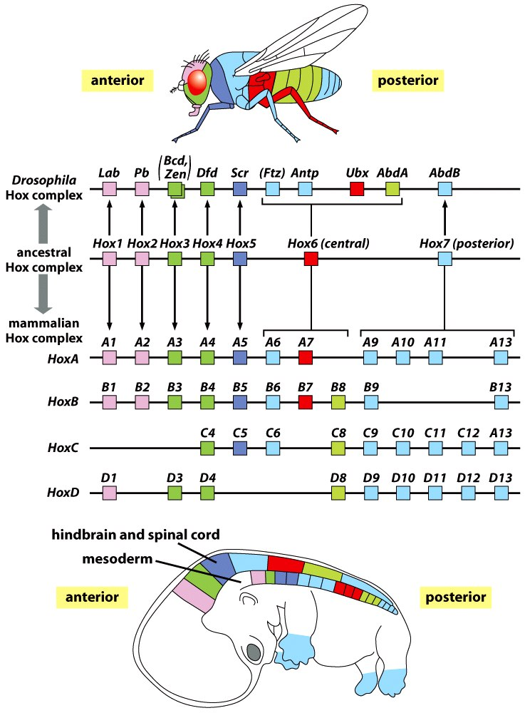
Genes Hox
Notes:
FIGURE 2.5 Hox gene clusters in arthropods (Drosophila) and vertebrates (mouse embryo) have a similar
spatial organization and similar order along the chromosomes. In Drosophila, the Hox gene cluster is aligned
on the chromosome such that the anterior most expressed gene is 3¢ and the posterior most gene is 5¢. In the
mouse, there are four separate Hox gene clusters on four different chromosomes, but the overall order is
similar to that in arthropods: the anterior to posterior order of gene expression is ordered in a 3¢ to 5¢ order
on the chromosomes.
FIGURE 2.7 What would the hindbrain look like without Hox genes? By eliminating the pbx genes from
the hindbrain of the zebrafish with a combination of genetic mutation and antisense oligonucleotide gene
inactivation, Moens and colleagues found that the “ground state” or default condition of the hindbrain is
rhombomere number 1. To the right is a drawing of the fish for orientation, with the hindbrain highlighted
in red. A, C, and E show the wild-type embryo, and panels B, D, F show the mutant embryo hindbrain. In
embryos lacking both pbx genes all segments are transformed into one long rhombomere 1, and both the specific
gene expression seen in rhombomeres 3, 4, and 5 (D) and the diversity of neurons that form in the hindbrain
(E) are lost in the mutant. (Modified from Waskiewicz et al., 2002)

Slide 17
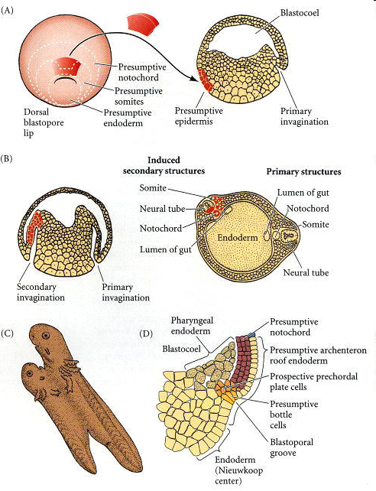
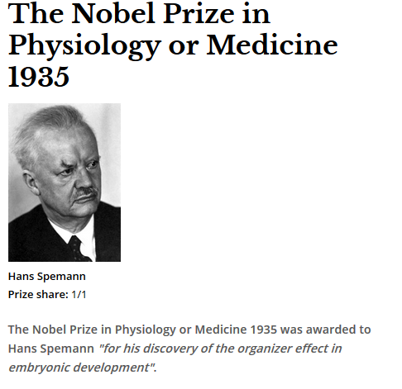
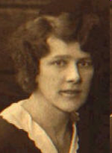
La
“inducción embrionaria”
Hilde Mangold
Notes:
Figure 10.20
.
Organization of a secondary axis by dorsal blastopore lip tissue. (A) Dorsal lip tissue from an early gastrula is transplanted into another early gastrula in the region that normally becomes ventral epidermis. (B) The donor tissue invaginates and forms a second archenteron, and then a second embryonic axis. Both donor and host tissues are seen in the new neural tube, notochord, and somites. (C) Eventually, a second embryo forms that is joined to the host. (D) Structure of the dorsal blastopore lip region in an early Xenopus gastrula. (A-C after Hamburger 1988; D after Winklbauer and Schürfeld 1999 and Arendt and Nübler-Jung 1999.)

Slide 18
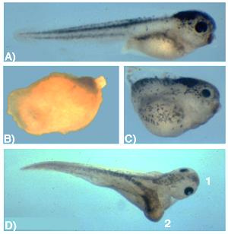
Inducción neural
BMPs y la hipótesis de la inducción neural “por defecto”
Control
mRNA BMP4
mRNA DN BMPR
mRNA
DN BMPR ventral
Notes:
FIGURE 1.21 Dissociation of animal cap cells prior to gastrulation
causes most of them to differentiate into neurons in culture.
Animal caps can be cultured intact (left) or dissociated into single
cells by removing the Ca+2 ions from the medium (middle and right).
If the intact caps are put into culture, they develop as epidermis
(left). If the dissociated animal cap cells are cultured, they develop
into neurons (red; middle). This result supports the hypothesis that
the neural fate is actively suppressed by cellular associations in the
ectoderm. If the cells are dissociated and then BMP is added to the
culture dish, the cells do not become neurons, but instead act as if
they are not dissociated and develop as epidermis (right).
BMP4 regulates dorsal-ventral patterning in Xenopusembryos. A) Control tadpole. B) Ventralised embryo injected with mRNA for BMP4 . C) Dorsalised embryo injected with mRNA for a dominant-negative BMP receptor. D) Partial duplicated dorsal axis caused by ventral injection of mRNA for a dominant-negative BMP receptor. http://www.ucl.ac.uk/cdb/research/dale/dale_lab

Slide 19
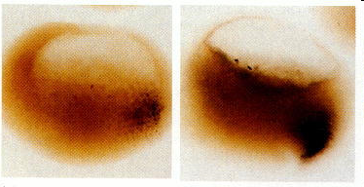
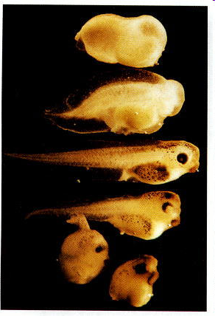
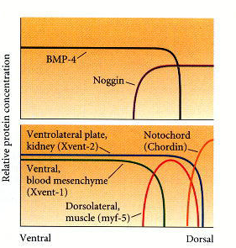
Moléculas involucradas en la inducción neural:
Inhibidores de BMPs
noggin
UV
noggin
Notes:
Figure 10.29
.
Rescue of dorsal structures by Noggin protein. When Xenopus eggs are exposed to ultraviolet radiation, cortical rotation fails to occur, and the embryos lack dorsal structures (top). If such an embryo is injected with noggin mRNA, it develops dorsal structures in a dosage-related fashion (top to bottom). If too much noggin message is injected, the embryo produces dorsal anterior tissue at the expense of ventral and posterior tissue, becoming little more than a head (bottom). (Photograph courtesy of R. M. Harland.)
FIGURE 1.24 Loss of noggin and chordin in developing mice causes severe defects in head development.
Left, wild-type mouse embryo, middle loss of noggin only. Right, loss of both noggin and chordin. From ref
with permission. Note that only mild defects are present in mice deficient in only noggin, but the head is
nearly absent when both genes are knocked out. (From Bachiller et al., 2000)
Figure 10.32
.
Model for the action of the organizer. (A) BMP4 (and certain other molecules) is a powerful ventralizing factor. Organizer proteins such as Chordin, Noggin, and Follistatin block the action of BMP4. The antagonistic effects of these proteins can be seen in all three germ layers. (B) BMP4 may elicit the expression of different genes in a concentration-dependent fashion; in that way, the mesoderm could be patterned. BMP4 is expressed throughout the marginal zone (prospective mesoderm) except in the dorsal domain. Noggin and Chordin are expressed in the dorsal domain. These proteins bind to BMP4 and prevent it from reaching the mesodermal cells. In the regions of noggin and chordin expression, BMP4 is totally prevented from binding, and these tissues become notochord (organizer) tissue. Slightly farther away from the organizer, myf5, a marker for the dorsolateral muscles, is activated. As more and more BMP4 molecules are allowed to bind to the cells, Xvent2 (ventrolateral) and Xvent1 (ventral) genes become expressed. (After Dosch et al. 1997.)

Slide 20
Señalización celular en la inducción neural
Notes:
FIGURE 1.34 The current model of neural induction. The default
condition of the ectoderm is to make epidermis, through the activation
of the BMP pathway. BMP in the ectoderm stimulates the receptor
to activate a set of intracellular proteins (Smad; see Box) that
regulate transcription of genes such as Gata and Msx. The resulting
Msx and Gata proteins inhibit Sox transcription, and the tissue
becomes epidermis. If the BMP signal is blocked by one of the many
inhibitors in the organizer, the Smad pathway is inactivated, and Sox
are made in the cells. The Sox can then directly activate the proneural
gene transcription to cause the cells to develop as nervous system.
FGF may provide an alternate pathway that directly activates Sox
expression, or might also work to inhibit the Smad signal (see Box).
Fig. 10 – Chordin (Chd) forms a ternary complex with BMP4
and Twisted gastrulation (Tsg), which prevents binding to
BMPR and allows the complex to diffuse within the embryo.
The inhibition of BMP signaling is reversed by a ventral
enzyme called Xolloid-related (Xlr) which is able to cleave
Chordin at two specific sites (indicated by scissors),
releasing BMPs for signaling through BMPR. Note that
Chordin has four BMP-binding Cysteine-rich modules called
CRs. CR domains function as regulators of BMP or TGF-b
signaling in many extracellular proteins (De Robertis and
Kuroda, 2004).
Figure 10.30
.
Localization of the noggin mRNA in the organizer tissue, shown by in situ hybridization. (A) At gastrulation, noggin message (dark areas) accumulates in the dorsal marginal zone. (B) When cells involute, noggin mRNA is seen in the dorsal blastopore lip. (C) During convergent extension, noggin message is expressed in the precursors of the notochord, prechordal plate, and pharyngeal endoderm, which extend (D) beneath the ectoderm in the center of the embryo. (Photographs courtesy of R. M. Harland.)

Slide 21
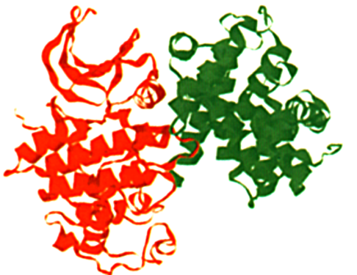
Tres mecanismos moleculares
Cdk
Ciclina
- “Switches moleculares”: unión
  Activación o inactivación de proteínas por fosforilación
- Regulación de la expresión génica:
  Factores de transcripción
- Señalización celular:
  Moléculas extracelulares
  Receptores de membrana
  Sistema de transducción intracelular

