Slide 1
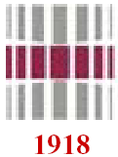
If cannot bear such conditions…
Sub-topics
Failure
Ductile and brittle fracture
Fracture toughness
Fundamentals of fracture mechanics

Slide 2
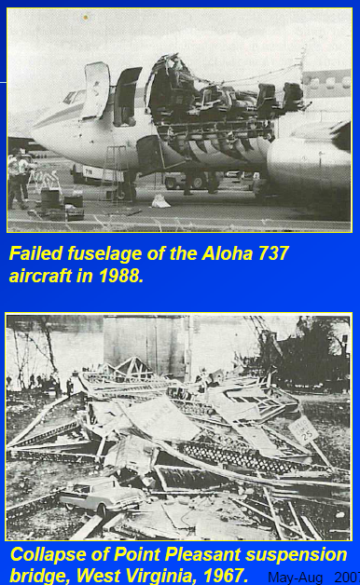
Failure
Failure in structures leads to lost of
properties and sometimes lost of
human lives.
An oil tanker that fractured in a brittle manner by crack propagation around its girth. (Photography by Neal Boenzi. Reprinted with permission from The New York Times.)

Slide 3
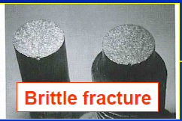
Types of fracture
Fracture is the separation of a body into two or more pieces in response to an imposed stress that is static and at temperatures that are low relative to the melting temperature of the material.

Slide 4
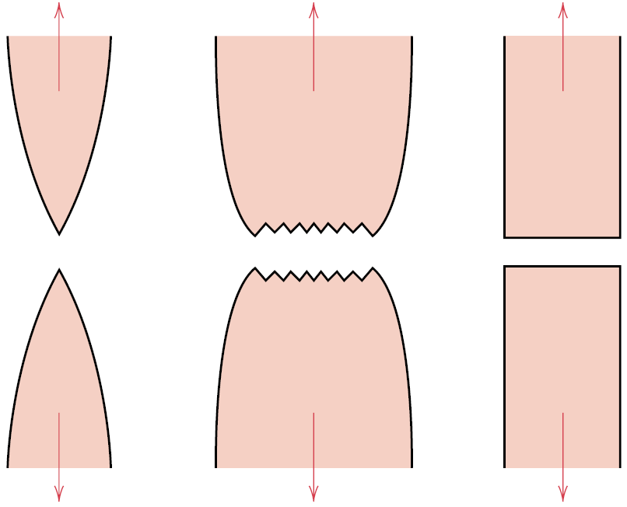
Failure modes
Ductile fracture is almost always preferred to brittle one.
Highly ductile fracture in
which the specimen necks down to a point
Moderately ductile fracture after some
necking.
Brittle fracture without any
plastic deformation.

Slide 5
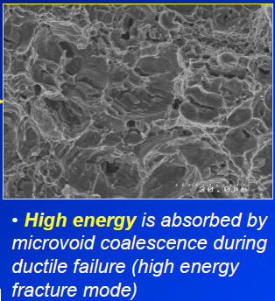
Ductile fracture
Highly ductile fracture in
which the specimen necks down to a point

Slide 6
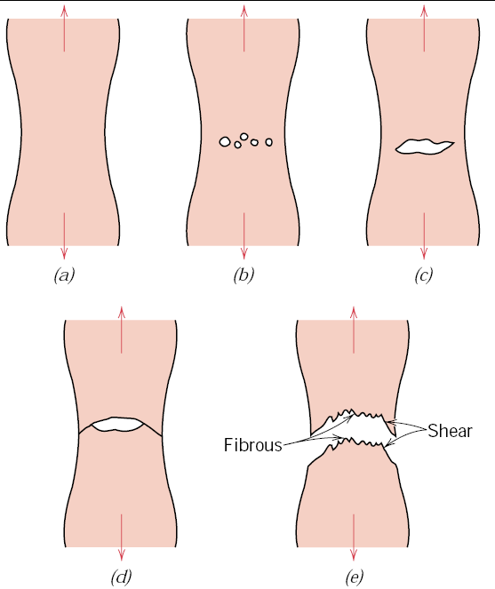
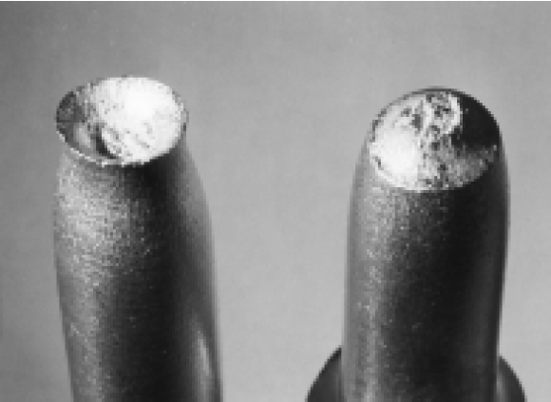
Ductile fracture
Small cavity formation
Initial necking.
Coalescence of
cavities to form a crack
Cup-and-cone fracture in aluminum.
Crack
propagation
Final shear fracture.

Slide 7
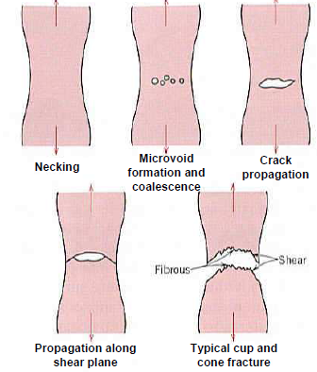
Tough “ductile” fracture
Ductile fracture is a much less serious
problem in engineering materials since
failure can be detected beforehand due
to observable plastic deformation
prior to failure.
Under uniaxial tensile force, after
necking, microvoids form and
coalesce to form crack, which then
propagate in the direction normal to
the tensile axis.
The crack then rapidly propagate
through the periphery along the shear
plane, leaving the cub and
cone fracture.

Slide 8
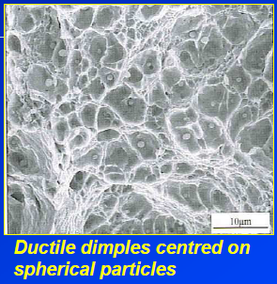
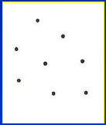
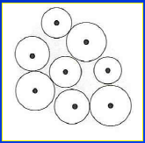
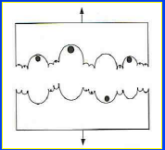
Microvoid formation, growth and coalescence
• Microvoids are easily formed at inclusions, intermetallic or second-phase particles and grain boundaries.
• Growth and coalescence of microvoids progress as the local applied load increases.
Random planar array
of particles acting as
void initiators
Linkage or coalescence
of these voids to form free fracture surface.
Growth of voids to join
each other as the applied
stress increases.

Slide 9
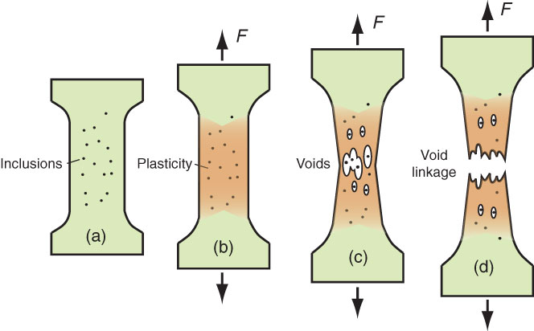
Ductile fracture of alloys
If materials is stretched, it firstly deforms uniformly.
Inclusions – stress concentrators

Slide 10
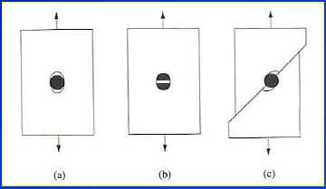
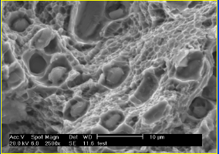
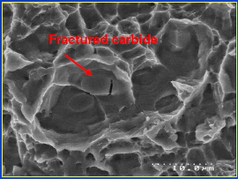
Formation of microvoids from second phase particles
1) Decohesion at particle -matrix interface.
2) Fracture of brittle particle
3) Decohesion of an interface associated with shear deformation or grain
boundary sliding.
Fractured carbides aiding
microvoid formation.
Decohesion of carbide particles
from Ti matrix.

Slide 11
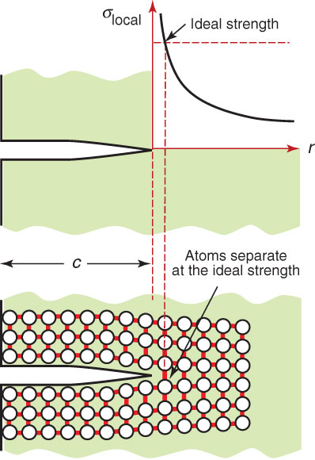
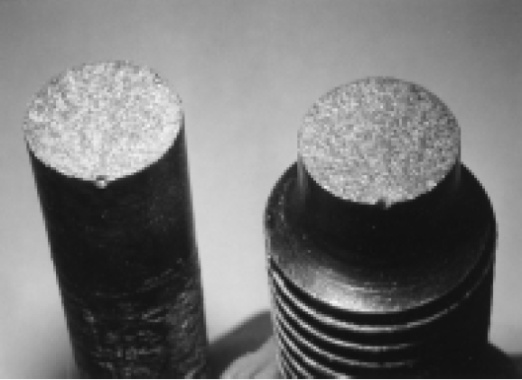
Brittle fracture

Slide 12
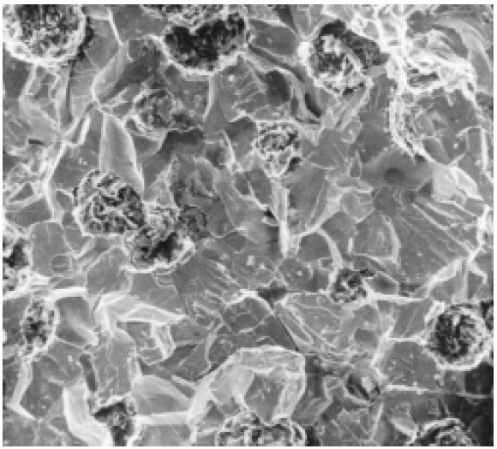
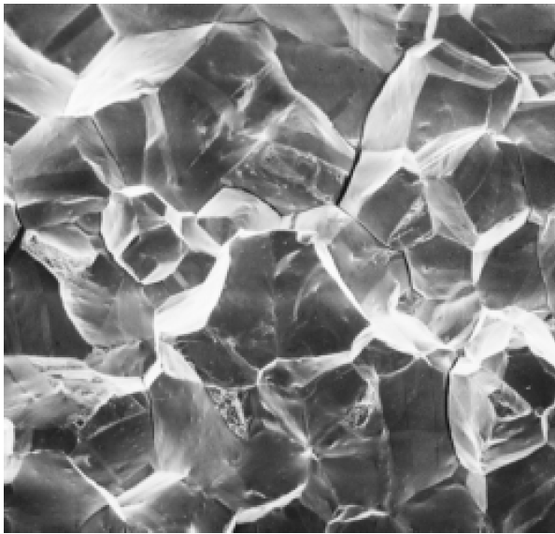
Fractografic studies
Scanning electron
fractograph of ductile
cast iron showing a transgranular fracture surface.
Scanning electron
fractograph showing
an intergranular
fracture surface.

Slide 13
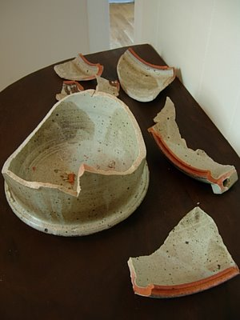
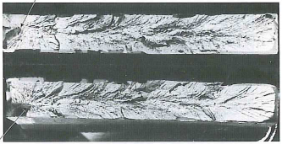
Nature of fracture: brittle
Characteristic for ceramics and glasses
Distinct characteristics of brittle fracture surfaces:
1) The absence of gross plastic deformation.
2) Grainy or Faceted texture.
3) “River” marking or stress lines.

Slide 14
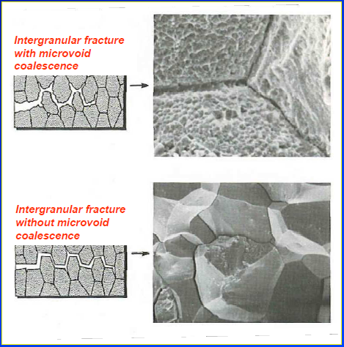
Intergranular fracture
• Intergranular failure is
a moderate to low energy
brittle fracture mode resulting
from grain boundary
separation or segregation of
embrittling particles or
precipitates.
• Embrittling grain
boundary particles are
weakly bonded with the
matrix, high free energy
and unstable, which leads to
preferential crack
propagation path.
Intergranular fracture with and without
microvoid coalescence

Slide 15
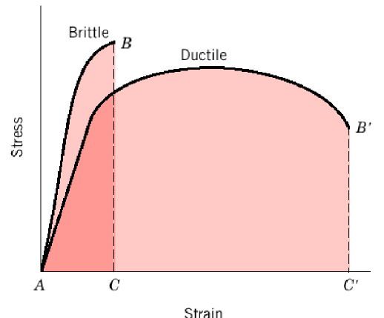
Strength and toughness
Strength
Resistance of a material
to plastic flow
Toughness
Resistance of a material
to the propagation
of a crack
How concerned should you be if you read in the paper that cracks have been detected in the pressure vessel of the nuclear reactor of the power station a few miles away?

Slide 16
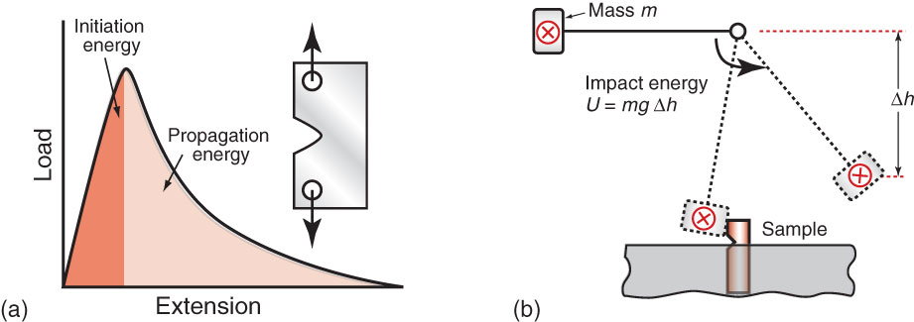
Testing for toughness
Measuring the energy
Tear test
Impact test
This type of test provides a comparison of the toughness of materials –
however, it does not provide a way to express toughness as a material property (no true material property that is independent on size and shape of the test sample)

Slide 17
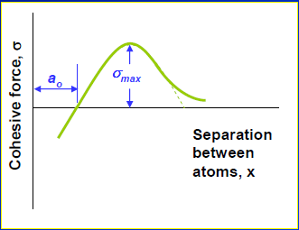
Introduction to fracture mechanics
The fracture strength of a solid material is a function of the
cohesive forces
that exist between atoms.
surface energy
unstrained interatomic spacing
On this basis, the theoretical cohesive strength of a brittle elastic solid has been estimated to be approximately E/10, where E is the modulus
of elasticity.
The experimental fracture strengths of most engineering materials
normally lie between 10 and 1000 times below this theoretical value.
Why?

Slide 18
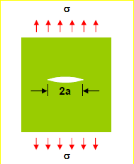
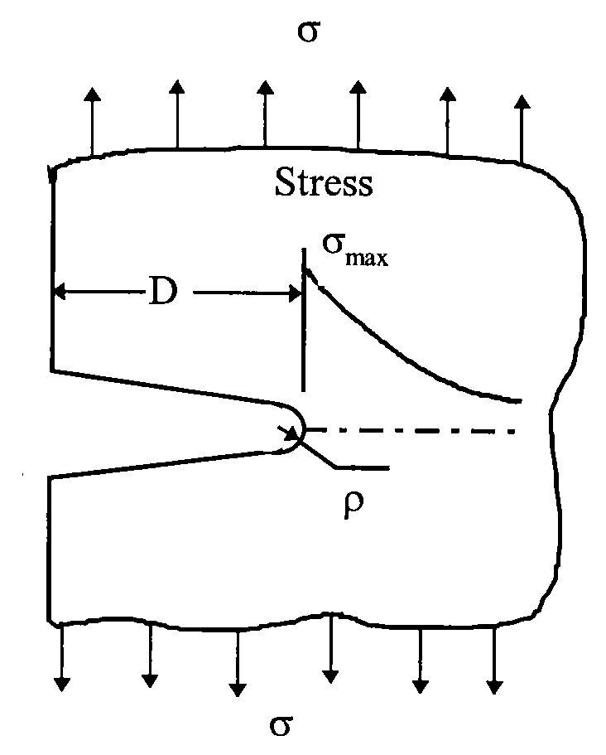
Stress concentration
Crack reduces the cross – section => increase in stress
What will happen with tough material?
Cracks concentrate stress
Flaws are detriment to the fracture strength because an applied stress may be amplified or concentrated at the tip, the magnitude of this amplification depends on crack orientation and geometry.

Slide 19
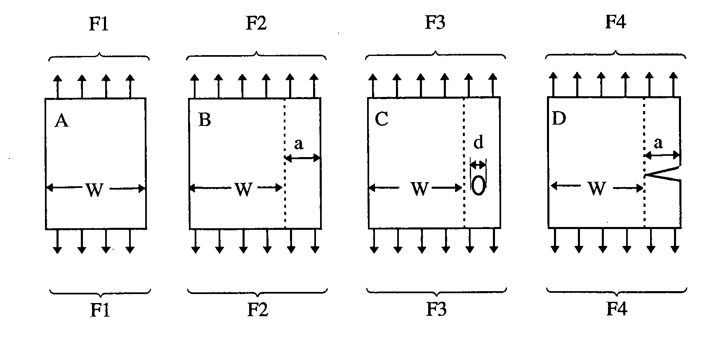
What force is required to break the samples?

Slide 20
Theories of brittle fracture

Slide 21
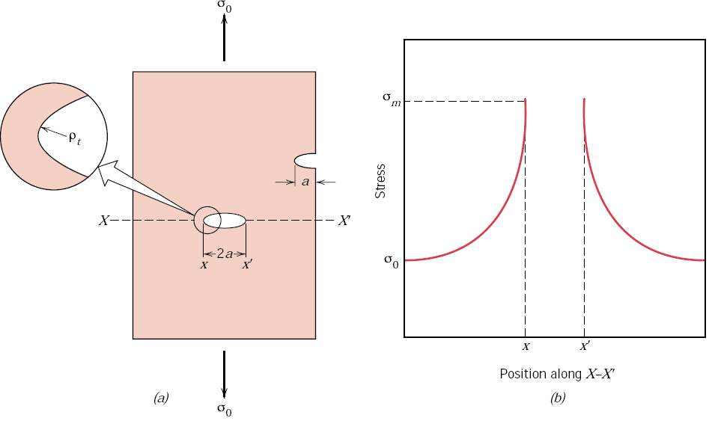
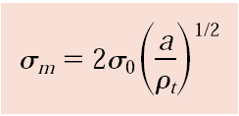
Stress concentrators
the magnitude of this localized stress
diminishes with distance away from the crack tip
The maximum stress at the crack tip
Schematic stress profile along the line X–X
A measure of the degree to which an external stress is amplified at the tip of a crack
stress concentration factor

Slide 22
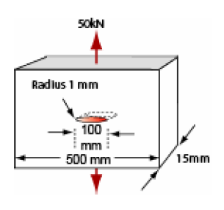
Problem
1. Consider a circular hole in a plate loaded in tension. When will material near the hole yield?
2. A plate with a rectangular section
500 mm by 15 mm carries a tensile load of 50kN.
It is made of a ductile metal with a yield strength of 50 MPa.
The plate contains an elliptical hole of length 100 mm and a minimum radius of 1 mm, oriented as shown in the diagram.
What is
(a) the nominal stress
(b) The maximum stress in the plate?
(c) Will the plate start to yield?
(d) Will it collapse completely?

Slide 23
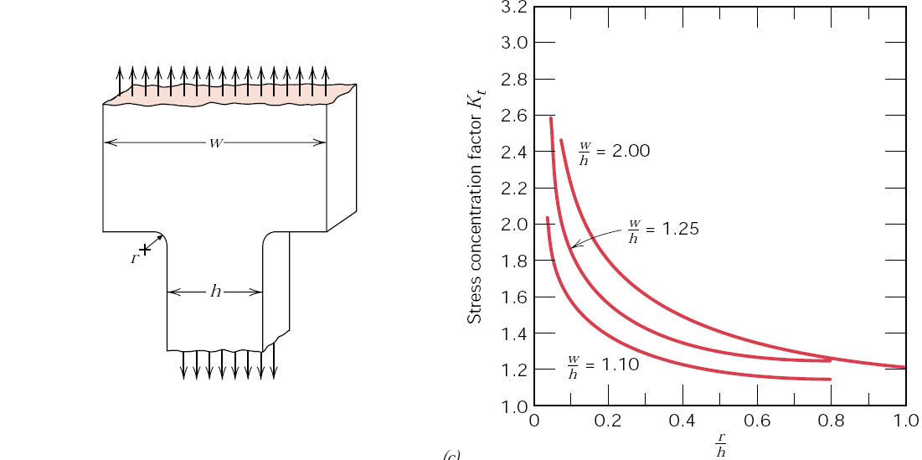
Theoretical stress concentration factor curves

Slide 24
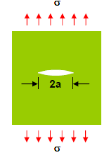
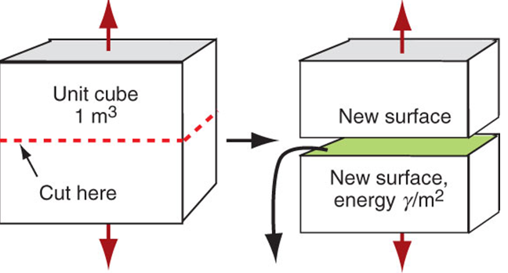
Griffith theory of brittle fracture
Inherent defects in brittle
materials lead to stress
concentration.
If stress exceeds the cohesive strength of bonds, crack extension is possible.
Thermodynamic criterion:
There are two energies to be taken into account when a crack propagates:
New surfaces should be created and a certain amount of energy must be provided to create them;
Elastic strain energy stored in the stressed material is released during crack propagation.

Slide 25
Theory of brittle fracture
The stress required to
create the new crack surface
G ≥ 2γ
Critical stress for crack propagation
The strain energy release rate (G) is higher for higher loads and larger cracks.
If the strain energy released exceeds a critical value,
then the crack will grow spontaneously.
For brittle materials, stress can be equal to the surface energy of the (two) new crack surfaces; in other words, in brittle materials, a crack will grow spontaneously if the strain energy released is equal to or greater than the energy required to grow the crack surface(s).
The stability condition can be written as
elastic energy released (G) = surface energy created (2γ)
If the elastic energy release is less than the critical value,
the crack will not grow.

Slide 26
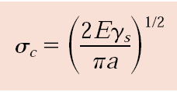
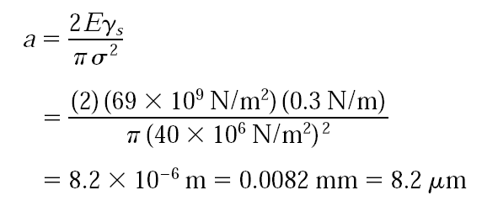
Problem
A relatively large plate of a glass is subjected to a tensile stress of 40 MPa. If the specific surface energy and modulus of elasticity for this glass are 0.3 J/m2 and 69 GPa, respectively,
determine the maximum length of a surface flaw that is possible without fracture.

Slide 27
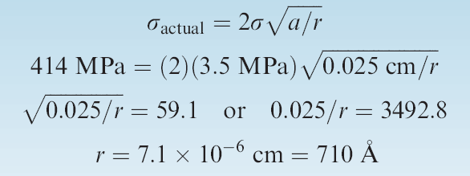
Problem: Properties of SiAlON Ceramics
Assume that an advanced ceramic, SiAlON (silicon aluminum oxynitride),
has a tensile strength of 414 MPa.
Let us assume that this value is for a flaw-free ceramic. (In practice, it is almost impossible to produce flaw-free ceramics.)
A crack 0.025 cm deep is observed before a SiAlON part is tested.
The part unexpectedly fails at a stress of 3.5 MPa by propagation of the crack.
Estimate the radius of the crack tip.

Slide 28
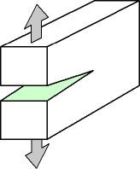
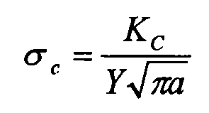
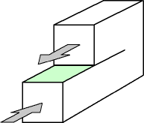
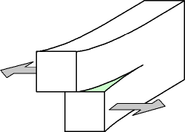
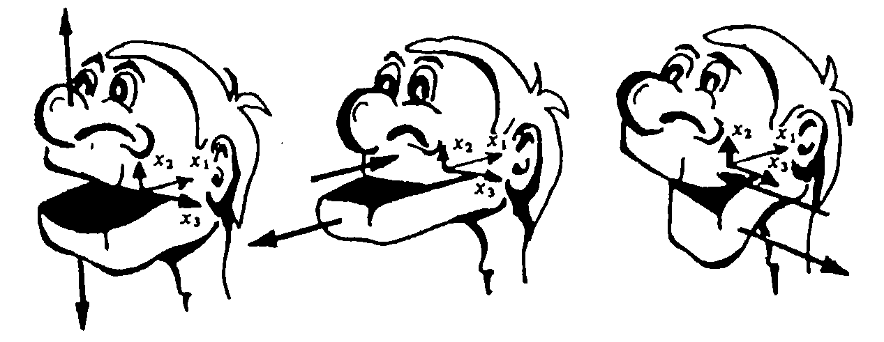
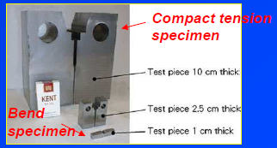
basic modes of crack tip deformation
K = (EG) ^{1/2}
critical stress for crack propagation
K_{IC} – the critical stress intensity in mode I fracture (plain strain)

Slide 29
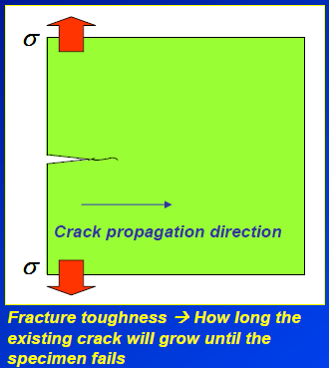
Fracture toughness
Fracture toughness
of a material is obtained by determining
the ability of a material to withstand the load in the presence of
a sharp crack before failure.
FT is a material property;
Value is independent of the way it is measured;
Can be used for design
Crack propagates when the stress intensity factor exceeds a critical value.
Y is a dimensionless parameter or function that depends on both crack and specimen sizes and geometries, as well as the manner of load application

Slide 30
Energy release rate
Irwin later modified the Griffith theory by replacing the term 2γ with the potential strain energy release rate G
When a samples fractures, a new surface is created => necessary conditions for fracture – sufficient energy release
G≥ 2γ
The critical condition to which the crack
propagates to cause global failure is when this G value exceeds the critical value
Irwin showed that G is measurable and can be related to the stress intensity factor, K

Slide 31
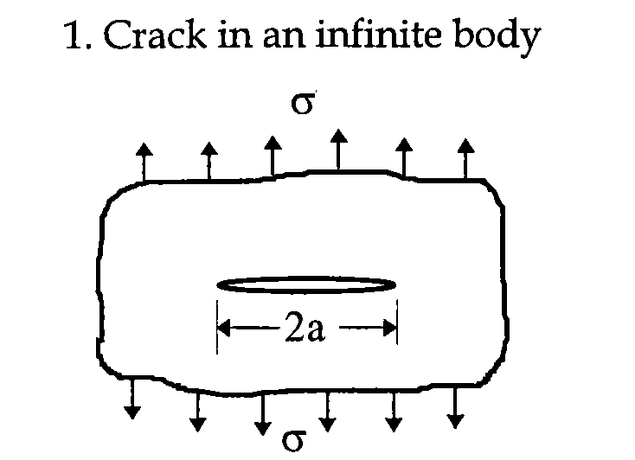
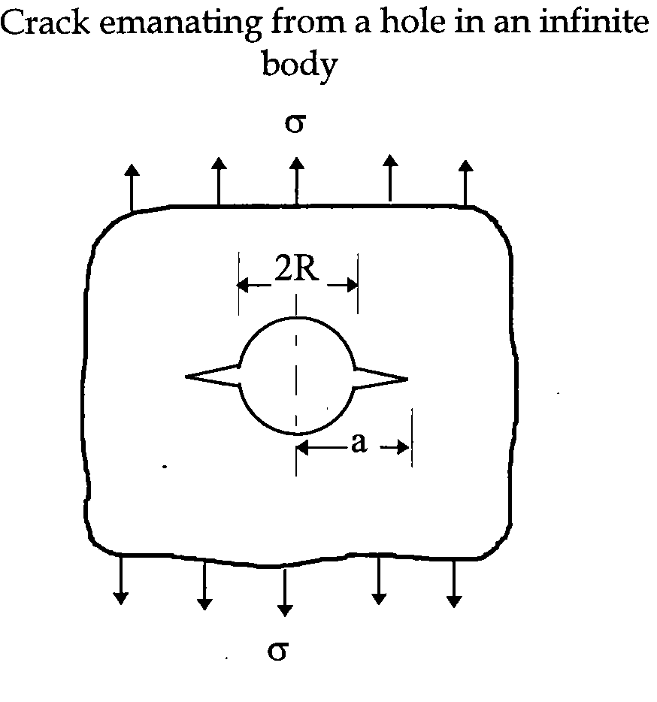
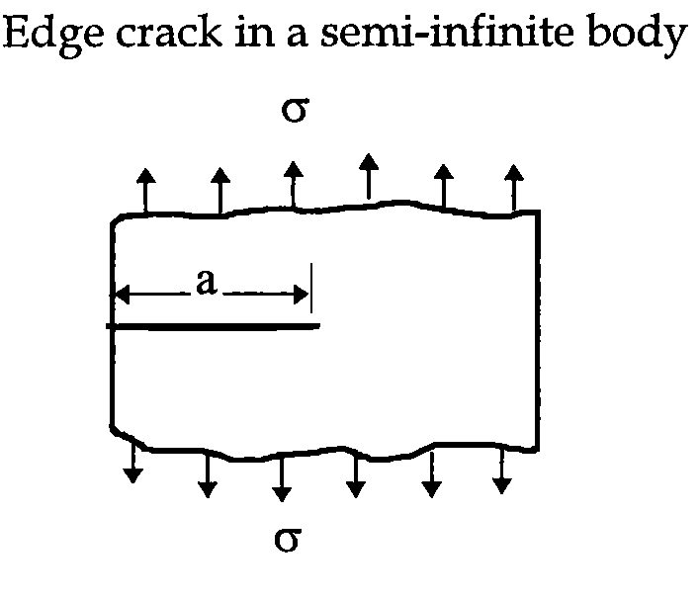
Y values of various crack geometries

Slide 32
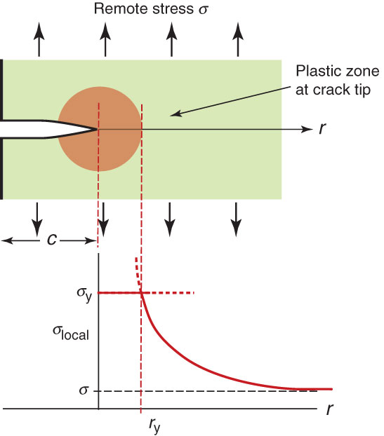
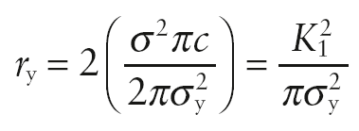
Process zone
A plastic zone forms at the
crack tip where the stress
would otherwise exceed
the yield strength
Size of process zone:

Slide 33
Brittle “cleavage” fracture
Materials of high yield strength
Near tip stress are very high =>
tear the atomic bonds apart =>
increase in the crack length results in increase in K, causing crack to accelerate

Slide 34
Fracture toughness and design
If the K_{IC} value of material is known and the presence of a crack is allowed, we can then monitor the crack propagation during service prior to failure =>
How long we can use the component before it fails.
Brittle materials, for which appreciable plastic deformation is not possible in front of an advancing crack, have low KIc values and are vulnerable to catastrophic failure.
Crack length necessary
for fracture at a materials
yield strength

Slide 35
Damage tolerance
Critical crack lengths are a measure of the
damage tolerance of a material
Tough metals are able to contain
large cracks but still yield in a
predictable, ductile, manner

Slide 36
Fracture resistance
The ability of a material to resist the growth of a crack depends on a large number of factors:
Larger flaws reduce the permitted stress.
The ability of a material to deform is critical.
Increasing the rate of application of the load, such as that encountered in an impact test, typically reduces the fracture toughness of the material.
Increasing the temperature normally increases the fracture toughness.

Slide 37
Variables affecting fracture toughness
Metallurgical factors
- Microstructure, inclusions, impurities
- Composition
- Heat treatment
Thermo-mechanical processing

Slide 38
Fracture toughness – modulus chart
Values range from 0.01 – 100 MPa√m

Slide 39
Transition crack length plotted on chart – values can range from near-atomic dimensions for ceramics to almost a meter for ductile metals

Slide 40
Fail-Safe Design
Yield-before-break
Requires that the crack will
not propagate even if the
stress causes the part to yield
Leak-before-break
Requires that a crack
just large enough to
penetrate both the inner
and outer surface of the
vessel is still stable

Slide 41
Design using fracture mechanics
wall stress
Consider the thin-walled spherical tank of radius r and thickness t that may be used as a pressure vessel.
One design of such a tank calls for yielding of the wall material prior to failure as a result of the formation of a crack of critical size and its subsequent rapid propagation.
Thus, plastic distortion of the wall may be observed and the pressure within the tank released before the occurrence of catastrophic failure.
Consequently, materials having large critical crack lengths are desired.
On the basis of this criterion, rank the metal alloys listed in Table, as to critical crack size, from longest to shortest.

Slide 42
Design process – yield-before-fracture
Requirement:
The stresses are everywhere less that required to make a crack of critical length to propagate.
BUT!!! It is not safe…
Requirement:
Crack should not propagate even if the stress is sufficient to cause general yield – for then the vessel will deform stably in a way that can be detected.
Tolerable crack size
≤

Slide 43
Design problem - leak-before-break
An alternative design that is also often utilized with pressure vessels is termed leak-before-break. Using principles of fracture mechanics, allowance is made for the growth of a crack through the thickness of the vessel wall prior to the occurrence of rapid crack propagation. Thus, the crack will completely penetrate the wall without catastrophic failure, allowing for its detection by the leaking of pressurized fluid.
With this criterion the critical crack length a_{c} (i.e., one-half of the total internal crack length) is taken to be equal to the pressure vessel thickness t.
2a = t
Using this criterion, rank the metal alloys in Table as to the maximum allowable pressure.
≤

Slide 44
Forensic fracture case
K_{1c} of the tank material measured to be 45 MPa√m
10 mm crack found in longitudinal weld
Stress based on
maximum design
pressure
Stress at which a plate with the given K_{1c} will fail with a 10 mm crack

Slide 45
Design of a ceramic support
Determine the minimum allowable thickness for a 7.5 cm wide plate made of sialon (SiAlON or silicon aluminumoxynitride) that has a fracture toughness of 9.9 Mpa m^{1/2}.
The plate must withstand a tensile load of 177 920 N.
The part will be non-destructively tested to ensure that no flaws are present that might cause failure.
The minimum allowable thickness of the part will depend on the minimum flaw size that can be determined by the available testing technique.
Assume that three non-destructive testing techniques are available:
X-ray radiography can detect flaws larger than 0.05 cm;
gamma-ray radiography can detect flaws larger than 0.02 cm; and ultrasonic inspection can detect flaws larger than 0.0125 cm.
Assume that the geometry factor f = 1.0 for all flaws.

Slide 46
Ductile-to-Brittle transition
At low temperatures some metals and all polymers become brittle
As temperatures decrease, yield strengths of most materials increase leading to a reduction in the plastic zone size
Only metals with an FCC structure remain ductile at the lowest temperatures
The ductile to brittle transition temperature is the temperature at which the failure mode of a material changes from ductile to brittle fracture.

Slide 47
Ductile to brittle transition behaviour
Some metals and polymers experience ductile-to-brittle transition behaviour when subjected to decreasing temperature, resulting from a strong yield stress dependence on temperature.
Metals possess limited
slip systems available at low temperature, minimising the plastic deformation during the
fracture process.
Increasing temperature
allows more slip systems to
operate, yielding general
plastic deformation to occur
prior to failure.

Slide 48
When ductile turn to brittle
The criterion for a material to change its fracture behaviour from ductile to brittle mode is when the yield stress at the observed temperature is larger than the stress necessary for the growth of the micro-crack indicated in the Griffith theory
The criterion for ductile to brittle transition is when the term on the left hand side is greater than the right hand side.
τ is the lattice resistance to dislocation movement
k’ is a parameter related to the release of dislocation into a pile-up
D is the grain diameter (associated with slip length).
G is the shear modulus
β is a constant depending on the stress system

Slide 49
Why don’t some materials undergo transition?
Unlike steel, aluminium does not undergo a ductile-brittle transition. The reason can be explained in terms of their crystal structure.
The yield stress of steel is temperature sensitive because of its BCC structure. At low temperatures it is more difficult for the dislocations to move (they require a degree of diffusion to move due to the non-close packed nature of the slip planes) and therefore plastic deformation becomes more difficult. The effect of this is to increase the yield stress at low temperatures.
Aluminium has a FCC structure, this means that it has lots of easily operated close-packed slip systems operating at low temperatures. As a result its yield strength is not temperature sensitive and aluminium remains ductile to low temperatures.

Slide 50
Bad luck of “Titanic”
The sinking of the “Titanic” was caused primarily by the brittleness of the steel used to construct the hull of the ship.
In the icy water of the Atlantic, the steel was below the ductile to brittle transition temperature.

Slide 51
Factors affecting modes of fracture
The yield stress of steel is temperature sensitive. The fracture stress remains relatively constant with temperature.
At room temperature steel is a ductile material, this means that it will undergo plastic deformation before fracture i.e. the yield strength of the material is less than the fracture stress.
At low temperatures the yield stress of steel increases, when the yield stress increases above the fracture stress the material will undergo a
ductile-to-brittle transition.

Slide 52
The Strength-Toughness trade-off
Increasing the yield
strength of a metal
decreasing the size
of the plastic zone
surrounding a crack –
this leads to decreased
toughness

Slide 53
Metallurgical aspect of fracture
• Microstructure in metallic materials are highly complex.
• Various microstructural features affect how the materials fracture
There are microstructural
features that can play a role in determining the fracture path, the most important are
• High strength materials usually possess several microstructural features in order to optimise mechanical properties by
influencing deformation behaviour /
fracture paths.

