Slide 1
Forces in engineering
Teacher: Clara Cnudde
Materials used for educational purposes

Slide 2
Material properties are physical, chemical, or mechanical components of a specific product that would determine its functionality and manufacturability. This would mean that a product’s material properties would specifically define the capabilities of the products in all aspects. Moreover, such a concept would set certain limitations—based on product composition or property—on the product’s performance. Conversely, a product’s intended functionality should also set specific property requirements that need to be met in order for the final product to be considered useful.

Slide 3
Physical Properties of Materials
A material’s physical properties denote the physical state of materials that are exclusive of their chemical or mechanical components. In particular, these properties encompass texture, density, mass, melting and boiling points, and electrical and thermal conductivity. All such physical properties are measurable or observable. These properties are not constant (will change when subjected to certain variables such as heat).
The most common physical properties that are used in selecting or differentiating materials:
Density – implies the weight of a material, with higher density rates implying heavier materials
Melting point – the minimum required temperature for a solid material to change into liquid
Color – the reflective property of a material
Boiling point – the minimum required temperature for a liquid material to change into gas

Slide 4
Mechanical Properties of Materials
A material’s mechanical properties refer to components that react against an applied load. An essential characteristic of all mechanical properties is their ability to describe the material’s ability to resist deformation. These mechanical properties determine the scope and limits of a material’s functionality, as well as establish expected service life or performance. Among industries, materials are usually classified and identified in terms of such properties. Common mechanical properties that are considered in a wide array of materials are stiffness, toughness, strength, ductility, hardness, and impact resistance.
The mechanical properties of materials are not constant; they continuously change when exposed to various conditions, such as heat or loading rate. Moreover, mechanical properties may be tested using the following methods:
Hardness testing – includes hardness tests such as Vickers, Rockwell, and Nanoindentation
Compression and fatigue testing – includes the testing of materials such as plastic, steel, or aluminum; also includes the testing of tensile strength
Scratch adhesion testing – measures adhesive failure and strength; typically utilized in meeting coating requirements

Slide 5
HOW TO EVALUATE MATERIALS-properties to consider:
Physical properties are measurable. Those are density, melting point, conductivity, coefficient of expansion, etc.
Mechanical properties are how the metal performs when different forces are applied to them. That includes strength, ductility, wear resistance, etc.

Slide 6
What is a force?
We all know from experience that a force is the amount of pushing or pulling required to move an object. Engineers determine the loads or external forces that act upon a structure. When external forces are applied to a structure, internal stresses (internal forces) develop resistance to the outside forces. The opposition of external and internal forces is what holds the structure together. Once engineers know the loads acting on a structure, they calculate the resulting internal stresses, and design each piece of the structure so that it is strong enough to carry the loads without breaking.

Slide 7
Force, in mechanics, is any action that tends to maintain or alter the motion of a body or to distort it. The concept of force is commonly explained in terms of Isaac Newton’s three laws of motion set forth in his Principia Mathematica (1687). According to Newton’s first principle, a body that is at rest or moving at a uniform rate in a straight line will remain in that state until some force is applied to it. The second law says that when an external force acts on a body, it produces an acceleration (change in velocity) of the body in the direction of the force. The magnitude of the acceleration is directly proportional to the magnitude of the external force and inversely proportional to the quantity of matter in the body. Newton’s third law states that when one body exerts a force on another body, the second body exerts an equal force on the first body. This principle of action and reaction explains why a force tends to deform a body (i.e., change its shape) whether or not it causes the body to move. The deformation of a body can usually be neglected when investigating its motion. BRITANNICA

Slide 13
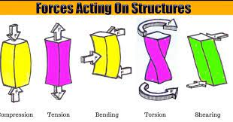
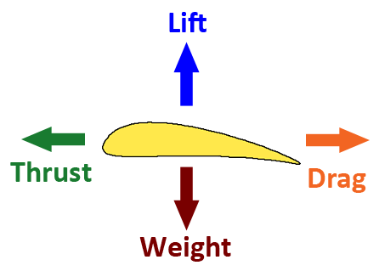
Engineers determine the loads or external forces that act upon a structure. When external forces are applied to a structure, internal stresses (internal forces) develop resistance to the outside forces. The opposition of external and internal forces is what holds the structure together.

Slide 14
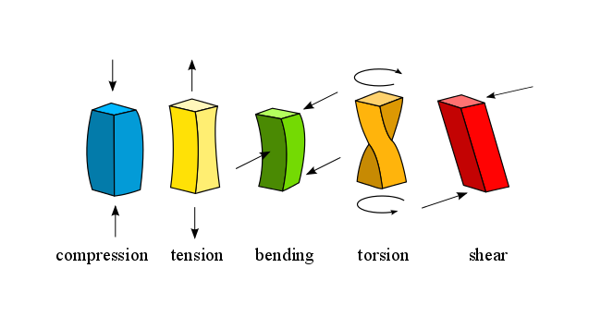

Slide 15
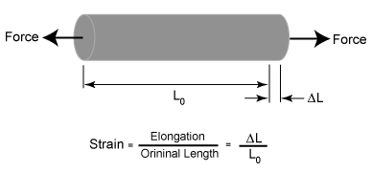
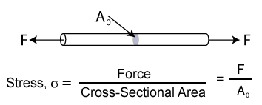
What is the difference between stress and strain?
Stress is the force applied to a material, divided by the material's cross-sectional area.
Strain is the deformation or displacement of material that results from an applied stress.

Slide 16
https://mechanicalengineering.blog/types-of-mechanical-forces/

Slide 18
(external forces)

Slide 21
https://jeopardylabs.com/play/gravity-buoyancy-elastic-forces-and-friction
https://quizizz.com/admin/quiz/5ce56aca8672c8001c37bd93/science-study-guide-forces-gravity-friction-buoyancy-elastic
https://quizizz.com/admin/search/FORCES?queryId=6249041c424562001f5255ae-1648952412603

Slide 22
https://create.kahoot.it/share/forces-in-engineering/7be93e52-c295-48a5-9f76-3beae746984c

