Slide 1
FINDING THE MAIN IDEA
Teacher: Clara Cnudde
Materials used for educational purposes.

Slide 3
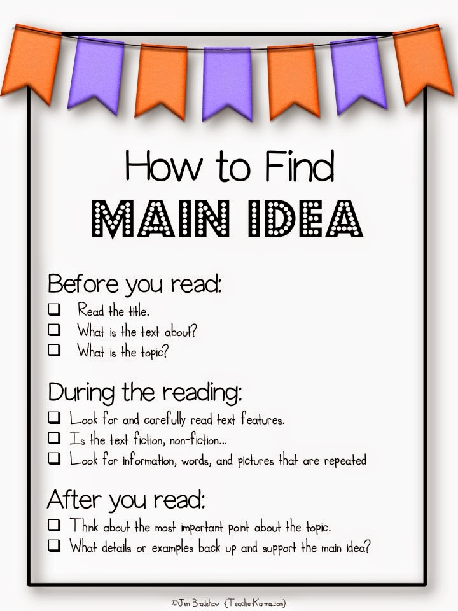

Slide 6
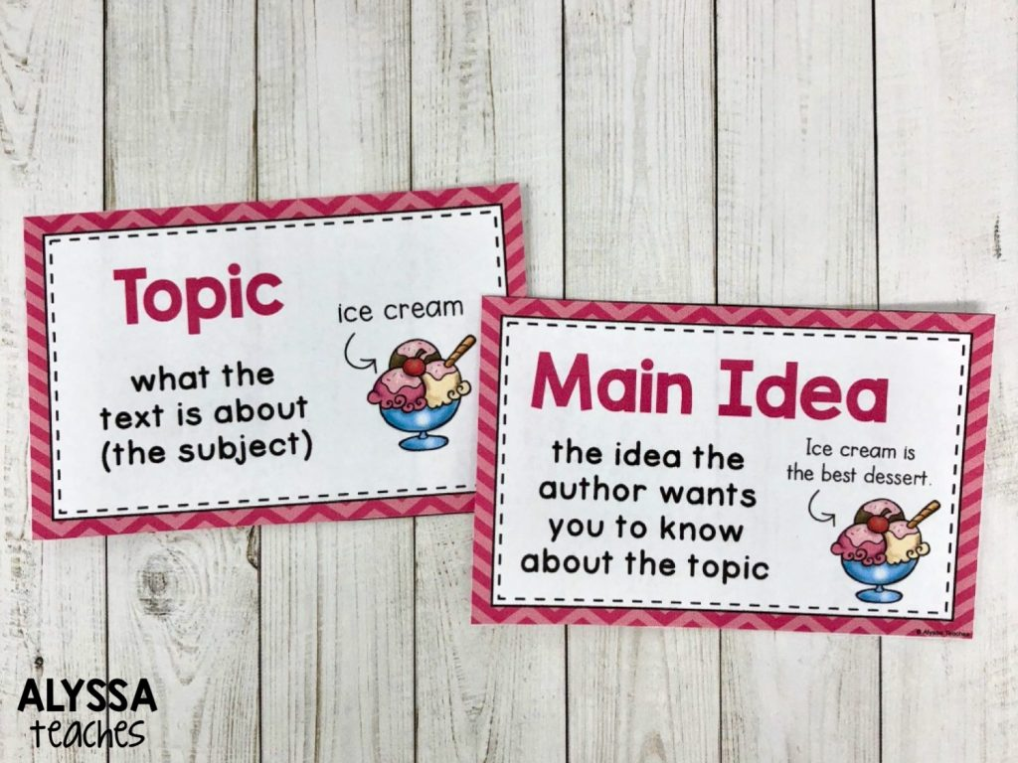

Slide 7
The main idea of a paragraph is the author's message about the topic. It is often expressed directly or it can be implied.
Where are the main ideas found?
It is easy to identify a main idea that is directly expressed in the text. Main ideas are often found:
at the beginning of paragraphs. The first sentence often explains the subject being discussed in the passage.
in the concluding sentences of a paragraph. The main idea can be expressed as a summation of the information in the paragraph as well as a link to the information in the next paragraph.

Slide 8
Find the main idea:
Mechanical engineering technologists construct, install and test new and already in-use equipment as per industry standards. It's a highly technical profession, where they plan efficient, cost-effective assembly line operations and upgraded machinery components using three-dimensional computer-aided design (CAD) software. Learning more about the roles and responsibilities of a mechanical engineering technologist can help you decide if you want to build a career in the field. In this article, we discuss what a mechanical engineering technologist does, highlight how to become one and list the required skills.

Slide 9
Find the main idea
Mechanical engineering technologists construct, install and test new and already in-use equipment as per industry standards. It's a highly technical profession, where they plan efficient, cost-effective assembly line operations and upgraded machinery components using three-dimensional computer-aided design (CAD) software. Learning more about the roles and responsibilities of a mechanical engineering technologist can help you decide if you want to build a career in the field. In this article, we discuss what a mechanical engineering technologist does, highlight how to become one and list the required skills.

Slide 10
The main idea is not always clearly stated. It is more difficult to identify a main idea when it is inferred or implied. It can be implied through other words in the paragraph. An implied main idea can be found in several ways:
Several sentences in a paragraph can imply the main idea by introducing facts about the topic before actually stating the topic.
Implied ideas can be drawn from facts, reasons, or examples that give hints or suggestions concerning the main idea. These hints will be clues leading you to discover the main idea in the selected text.
Try the passage below to see if you can pick out the main idea.

Slide 11
What information can you infer from this text?
Mechanical engineers are those general engineers who take on the major tasks of analyzing, designing and building new engines and thermal products, or updating items like medical devices. Mechanical technologists are those trained personnel who work closely with engineers interpreting their drafts and designs. They will work as go-betweens with work crews and engineers. Technicians also work with engineers, but in most companies they will work directly under a technologist doing much of the more basic work This might include data collection and analysis, double-checking schematic specifications, and providing tech support for other employees.

Slide 12
What information can you infer from this text?
Mechanical engineers are those general engineers who take on the major tasks of analyzing, designing and building new engines and thermal products, or updating items like medical devices. Mechanical technologists are those trained personnel who work closely with engineers interpreting their drafts and designs. They will work as go-betweens with work crews and engineers. Technicians also work with engineers, but in most companies they will work directly under a technologist doing much of the more basic work. This might include data collection and analysis, double-checking schematic specifications, and providing tech support for other employees.
Mechanical engineers, technologists and technicians can work together in a Project .
They work within a hierarchy.
They have different responsibilities.

Slide 13
What is the topic?
What is the main idea?
Mechanical engineers are those general engineers who take on the major tasks of analyzing, designing and building new engines and thermal products, or updating items like medical devices. Mechanical technologists are those trained personnel who work closely with engineers interpreting their drafts and designs. They will work as go-betweens with work crews and engineers. Technicians also work with engineers, but in most companies they will work directly under a technologist doing much of the more basic work This might include data collection and analysis, double-checking schematic specifications, and providing tech support for other employees.

Slide 14
What is the topic?
Tasks and responsibilities of engineers, technologists and technicians
What is the main idea?
Engineers, technologists and technicians work collaboratively in a Project but with different responsibilities.
Mechanical engineers are those general engineers who take on the major tasks of analyzing, designing and building new engines and thermal products, or updating items like medical devices. Mechanical technologists are those trained personnel who work closely with engineers interpreting their drafts and designs. They will work as go-betweens with work crews and engineers. Technicians also work with engineers, but in most companies they will work directly under a technologist doing much of the more basic work. This might include data collection and analysis, double-checking schematic specifications, and providing tech support for other employees.

Slide 15
After reading a paragraph ask yourself, "What point is the author making in this passage?"
Ask the following questions:
Who - Does this passage discuss a person or group of people?
When - Does the information contain a reference to time?
Where - Does the text name a place?
Why - Do you find a reason or explanation for something that happened?
How - Does this information indicate a method? or a theory?

Slide 16
How can I determine if I have selected the correct main idea of a paragraph?
If you are able to summarize the information in the passage in your own words, you have absorbed the correct main idea. To accomplish this goal, try the steps listed below after reading a short section of your textbook.
Write a short summary in your own words about what you have read.
Does your summary agree with this general topic?
Does your summary contain the same ideas being expressed by the author?
Could you write a headline (or textbook subheading) that would express your summary in less than five words?
If you are able to rephrase your choice of a topic sentence into a question and then determine if the passage answers your question, you have been successful at selecting a main idea.

Slide 18
https://create.kahoot.it/details/bc2c8543-5f52-46d5-8f43-bba8d28270f0

