Slide 1
YANG
Roque Gagliano

Slide 2
YANG Status
YANG 1.0 is currently most popular
YANG 1.1 just released
Some backward incompatibilities (YANG 1.0 is not obsolete)
Version needs to be there for 1.1 support
YANG models are organized in modules (that can also have sub-modules)
YANG modules name match the file name.yang
If there is YANG, there is a YIN

Slide 3
YANG to YIN to YANG is lossless

Slide 4
YANG is not only for configuration: Model-driven telemetry or Orchestrated assurance
Orchestrated assurance:
Assurance hand-over should be part of the provisioning process
Modeling assurance should be part of service design
Model-driven telemetry:
Using YANG models for telemetry data exposed from the devices to the collectors
gRPC proposed as transport option:
gNMI - gRPC Network Management Interface
Required for ”reactive-design” or “close-loop design”

Slide 5
YANG Tools
YANG Editors with plugins:
VI
Emacs
Eclipse
Sublime
Commercials…
YANG OS Tools:
PYANG
YANG to Python objects: pyangbind: https://github.com/robshakir/pyangbind

Slide 6
PYANG: An extensible YANG validator and converter in python
Validate YANG modules.
Convert YANG modules to YIN, and YIN to YANG.
Translate YANG data models to DSDL schemas, which can be used for validating various XML instance documents. See InstanceValidation.
Translate YANG data models to XSD.
Generate UML diagrams from YANG models. See UMLOutput for an example.
Generate compact tree representation of YANG models for quick visualization. See TreeOutput for an example.
Generate a skeleton XML instance document from the data model.
Schema-aware translation of instance documents encoded in XML to JSON and vice-versa. See XmlJson.
Plugin framework for simple development of other outputs, such as code generation.

Slide 7
YANG Content – Order is important
module <module-name>
{ // header information
<yang-version statement>
<namespace statement>
<prefix statement>
// linkage statements
<import statements>
<include statements>
// meta information
<organization statement>
<contact statement>
<description statement>
<reference statement>
// revision history
<revision statements>
// module definitions
<other statements> }

Slide 8
Augment Statement
Allows a module (or submodule) to add to schema tree define by another module

Slide 9
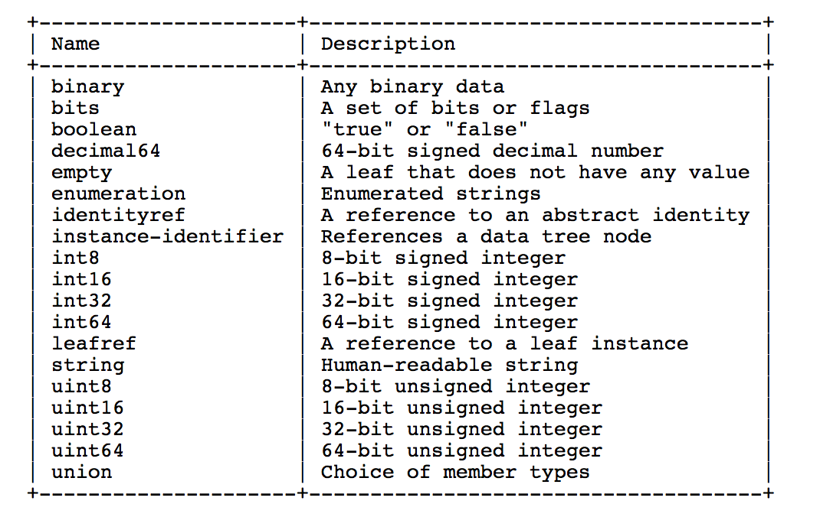
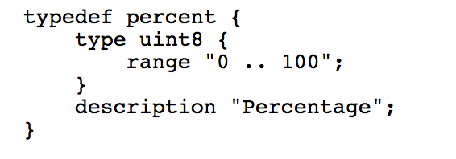
Yang Base Types
Augmenting:
Restrictions:
For integer:
range (include max)
For string:
length
pattern
Union statements: Allows special types

Slide 10
Use RFC7950 as documentation YANG Grouping Statement + Grouping statements with ”refine”

Slide 11
YANG Data Definitions

Slide 12
Leaf Statement

Slide 13
Container statement

Slide 14
Leaf-list statement

Slide 15
List Statement

Slide 16
Leafref

Slide 17
Deref() XPATH Operator

Slide 18
YANG Actions, RPCs and Notifications

Slide 19
YANG RPC Statement:
Administrative actions with input and outputs
No tied with any node
YANG Action Statement:
Administrative actions with input and outputs
Tied to a specific node

Slide 20
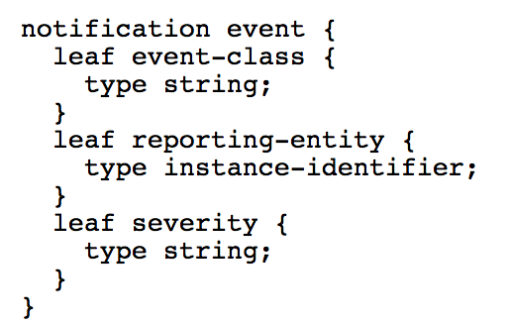
YANG Notification statement
Used to define notifications
One single argument as identifier
Followed by sub-statements with detail information

Slide 21
Advance YANG statements
choice
must
when
identity
feature
deviations

Slide 22
Upgrading a YANG module Rules are written in standard (example of rules)
MUST add revision statement
An "enumeration" type may have new enums added (at the end please), provided the old enums's values do not change.
A "range", "length", or "pattern" statement may expand the allowed value space.
A "min-elements" statement may be removed, or changed to require fewer elements.
New data definition statements may be added if they do not add mandatory nodes to existing nodes or at the top level in a module or submodule, or if they are conditionally dependent on a new feature

