Slide 1
Short introduction to complexity
Roque Gagliano

Slide 2
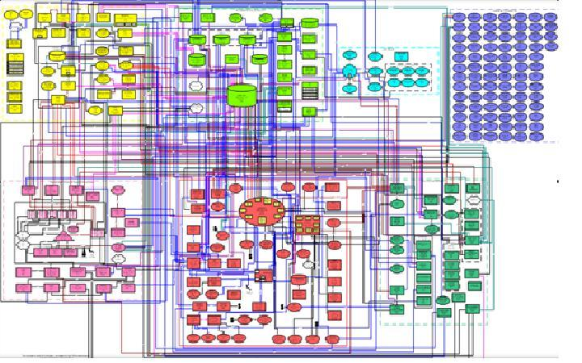
The current Telco service reality
Image source: Forrester, Kate Legget blog, 2011 (North American Telecom Company)

Slide 3
Complexity comes from hidden structure Which is not always evil
Complexity is (mostly) hidden structure that arises in systems
Its purpose is to create robustness to environmental and component uncertainty
Examples of hidden structures for service provisioning are: high-availability (reliability), scalability, efficiency,…
Robustness is the preservation of a certain property in the presence of uncertainty in components or the environment. Example: Transaction support: “all or nothing”
Fragility is the opposite of robustness
Source: David Meyer series on complexity for Networks

Slide 4
We need complexity to achieve robustness But too much complexity brings no benefit
Source: David Meyer series on complexity for Networks

Slide 5
We are about complexity in two areas Provisioning + Activation system designs and service design
Provisioning + Activation system designs: how are we architecting our systems?
Service Design: For a given service, how are we architecting our business logic?

Slide 6
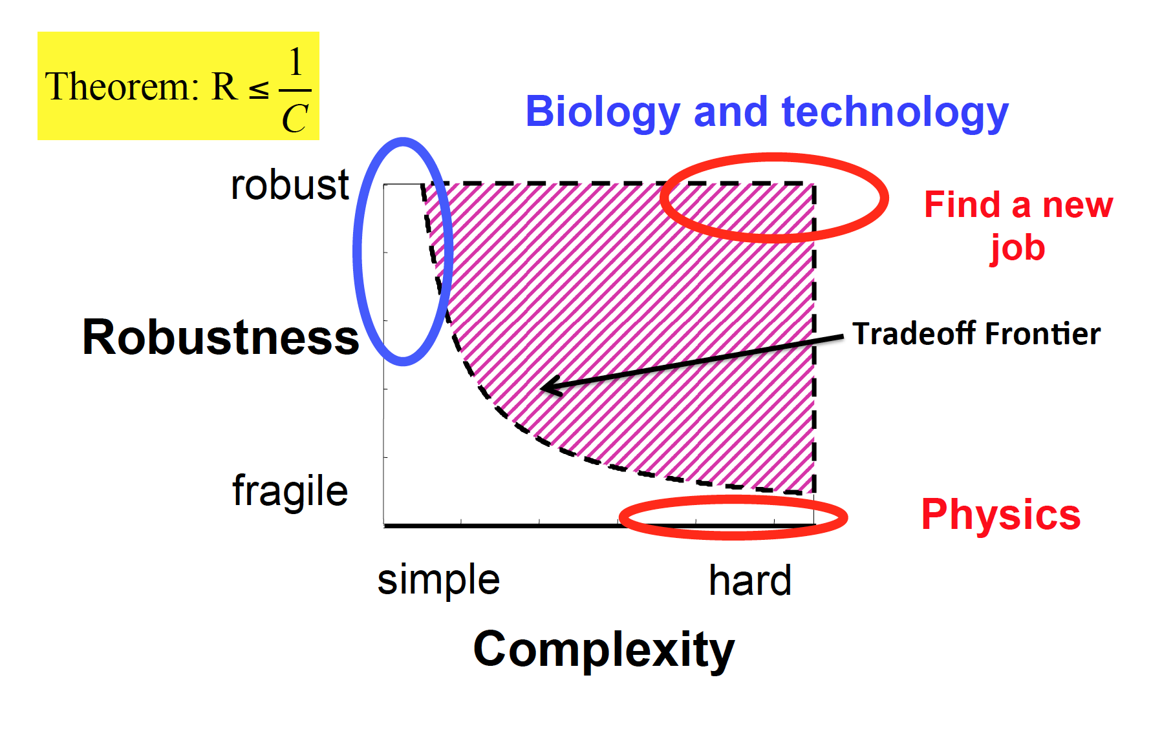
Robust Yet Fragile (RYF) tradeoff
Robust to some perturbations, yet fragile for a different set of perturbations
Investment dimension is not shown
The key is to understand the trade-off that I make
Source: David Meyer series on complexity for Networks

Slide 7
The Architecture of complexity Hierarchical and near-decomposable systems for a faster evolution
Complex systems are build in hierarchical layers of subsystems: “parts within parts”
Examples are all over: biology, physics, society, computer science
Nearly-Decomposition: Dependencies between subsystems are taking to a minimum.
Hierarchical nearly-decomposed complex-systems will evolve more rapidly than single systems
We can find dependencies on the width and span of these systems
Example for service provisioning: vertical vs horizontal integrations
Source: Herbert A. Simon, 1962

Slide 8
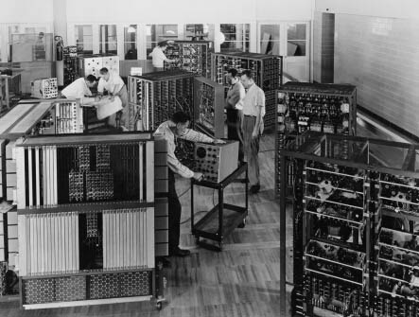
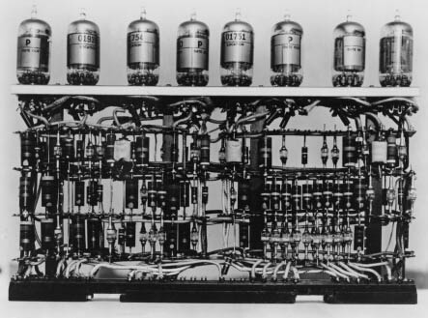
Every Industry Modularizes as Complexity Increases
1953 – IBM 701 ‘Defense Calculator’
Custom-built machines
Core competencies:
Integrated engineering and production
Solving technical inter-dependencies
Source: IBM

Slide 9
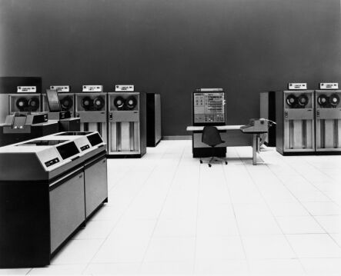
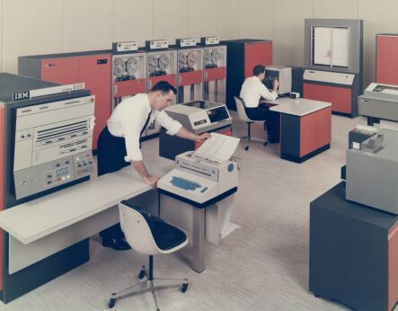
Every Industry Modularizes as Complexity Increases
1964 – IBM System/360
’
General purpose machines
Core competencies:
Modular engineering and production
Removing technical inter-dependencies
Source: IBM

Slide 10
How can I organize my subsystems to improve RYF tradeoffs? Biology and protocol design have something to say
Apps
Operating
System
HW
Source: David Meyer series on complexity for Networks

Slide 11
The resource-facing layer is becoming the OS of the network A key piece of the complex architecture
Customer Facing Service Provisioning
Infrastructure Service
Operations
Services
Operations
Services
many
Resource Facing Orchestration
few
Routers
NMS
DC
Virtual
Assurance
Vendor A
Vendor B
many
Vendor C
Vendor D

Slide 12
Same Complexity architecture can be applied to service design Network Service Header technical service design
Fix Line Service Chain Service
Mobile Service Chain Service
many
Rendered Service Path
few
Explicit Rendered Service Path
A to Z
Explicit Rendered Service Path
Z to A
many
Service Chain Classifier
Service Chain Classifier
Resource-facing orchestrator
Service Function
Forwarders (SFF)
Service Function
Forwarders (SFF)
Service Function Classifiers (SFC)
Service Function Classifiers (SFC)

Slide 13
Model-driven systems
“…we need something stronger than interface definition languages…”

Slide 14
Modeling is a synonym of abstraction
Abstraction consists on the capacity of finding the commonality in many different observations:
Generalization: generalize specific features of real objects
Classification: classify the objects into coherent clusters
Aggregation: aggregate objects in more complex ones
A model will therefore be a partial representation of reality, defined in order to accomplish a specific task.
Models can have different purposes: 1) descriptive 2) prescriptive or 3) describing how a system shall be implemented
Source: Model-driven Software Engineering in Practice -

Slide 15
Model-driven Software Engineering (MDSE) A growing trend in software development
MDSE has shown to increase efficiency and effectiveness for software development because:
1- Software artifacts are becoming more and more complex and needs to be discussed between different stakeholders at different levels and phases of development
2- The requirement to be agile in creating new pieces of software and continuously evolution of the existing pieces
3- Shortage of software development skills, allows the key people to focus on a backend platform and less skill people work on model development
4- The requirement to interact with non developers: customers, managers, etc.
Source: Model-driven Software Engineering in Practice -

Slide 16
Translating this facts to Telecom service design
Model driven systems are becoming more adopted because:
Telecommunication services are becoming more complex, involving multiple domains and technologies. We need to get engineers from all these departments to work on abstractions: mobile, optical, IP, DC, etc.
We need services to be agile because: we want to add new services (= new softare), we want to modify existing services ( changing implementation details or adding a new vendor, etc.)
There is shortage of software skills in the Telecom industry and it would be impossible to get everyone to be both: software and domain experts.
More a more interactions are needed between service designers and areas such as marketing, customers, etc.

Slide 17
Modeling additional advantages
Syntactical validation
Model Transformation
Model Execution
Model checking
Model Simulation
Model Debugging
Source: Model-driven Software Engineering in Practice -

Slide 18
Everything is a model!
- Traditional Business Logic implementation (Niklaus Wirth):
Data Structures + Algorithms = Programs
MDSE concept:
Models + Transformations = Software (Orchestration business logic)
Models and Transformations needs to be expressed in some notation: Modeling language
INPUT
Business Logic
OUTPUT

Slide 19
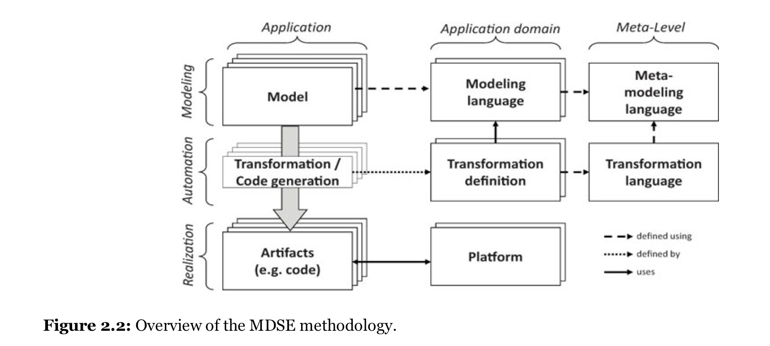
Puttying all together in the MDSE methodology
Source: Model-driven Software Engineering in Practice -

Slide 20
Modeling Languages
General-Purpose Modeling Languages: UML (Unified Modeling Language) from Object Management Group (OMG)
Domain-specific Modeling Languages (the once we are interested):
For Provisioning layer: Business Process Model and Notation (BTMN) from OMG
For Activation layer: YANG Modeling Language from IETF. We will have a complete module on YANG…

Slide 21
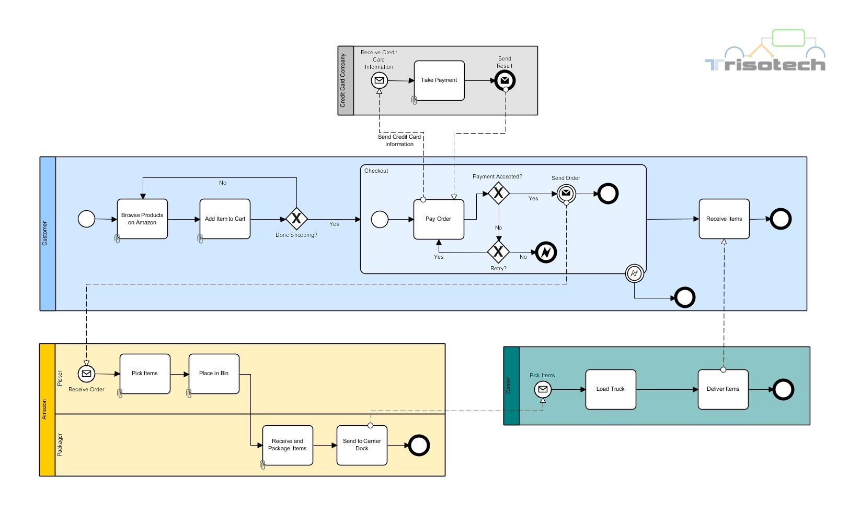
Business Process Model and Notation Big focus on graphical tools to model processes, code is XML
<semantic:process isExecutable="false" id="WFP-Page_1-2" name="Buying at Amazon Collaboration - Carrier - Process" triso:defaultName="true"> <semantic:task id="__f867d5f7-db1e-4015-9856-c53bc9cb4b51" name="Deliver Items" startQuantity="1" completionQuantity="1" isForCompensation="false"> <semantic:incoming>__36fbe220-08cc-45e8-847b-3f55002979c2</semantic:incoming> <semantic:outgoing>__b355021c-ac23-48bf-9d1a-45c32565ba39</semantic:outgoing> </semantic:task> <semantic:sequenceFlow id="__b355021c-ac23-48bf-9d1a-45c32565ba39" sourceRef="__f867d5f7-db1e-4015-9856-c53bc9cb4b51" targetRef="__6c41ae4a-64fd-40f9-a764-059b26ef8ebf"/> <semantic:sequenceFlow id="__36fbe220-08cc-45e8-847b-3f55002979c2" sourceRef="__a9de74be-ce4b-4d59-bafd-cf6f61f48867" targetRef="__f867d5f7-db1e-4015-9856-c53bc9cb4b51"/> <semantic:task id="__a9de74be-ce4b-4d59-bafd-cf6f61f48867" name="Load Truck" startQuantity="1" completionQuantity="1" isForCompensation="false"> <semantic:incoming>__474f19b8-f608-4d20-a49e-907485a789c5</semantic:incoming> <semantic:outgoing>__36fbe220-08cc-45e8-847b-3f55002979c2</semantic:outgoing> </semantic:task> <semantic:sequenceFlow id="__474f19b8-f608-4d20-a49e-907485a789c5" sourceRef="__e6a9dd54-6cb0-4713-8b77-e659f2658e40" targetRef="__a9de74be-ce4b-4d59-bafd-cf6f61f48867"/> <semantic:endEvent id="__6c41ae4a-64fd-40f9-a764-059b26ef8ebf"> <semantic:incoming>__b355021c-ac23-48bf-9d1a-45c32565ba39</semantic:incoming> </semantic:endEvent> <semantic:startEvent id="__e6a9dd54-6cb0-4713-8b77-e659f2658e40" name="Pick Items" isInterrupting="true"> <semantic:outgoing>__474f19b8-f608-4d20-a49e-907485a789c5</semantic:outgoing> <semantic:messageEventDefinition messageRef="Message_1404332496323"/> </semantic:startEvent> </semantic:process>
Source: bpmn.org

Slide 22
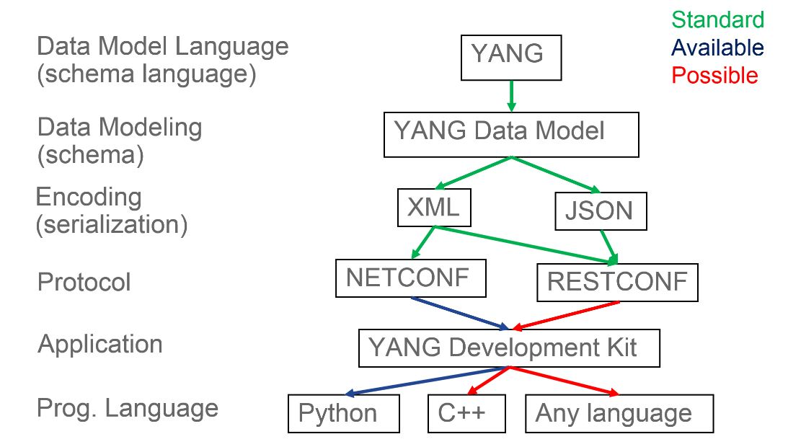
NETCONF/YANG architecture and history
2003 – IAB Workshop and RFC 3535: we need to improve net. management
2006 – NETCONF RFC 4741
SDN Buzz
2010 – YANG 1.0 RFC 6020
2011 – NETCONF Updated RFC 6241
YANG model explosion at IETF, MEF, BF, etc.
2016 – YANG 1.1 RFC 7950
2017 – RESTCONF

Slide 23
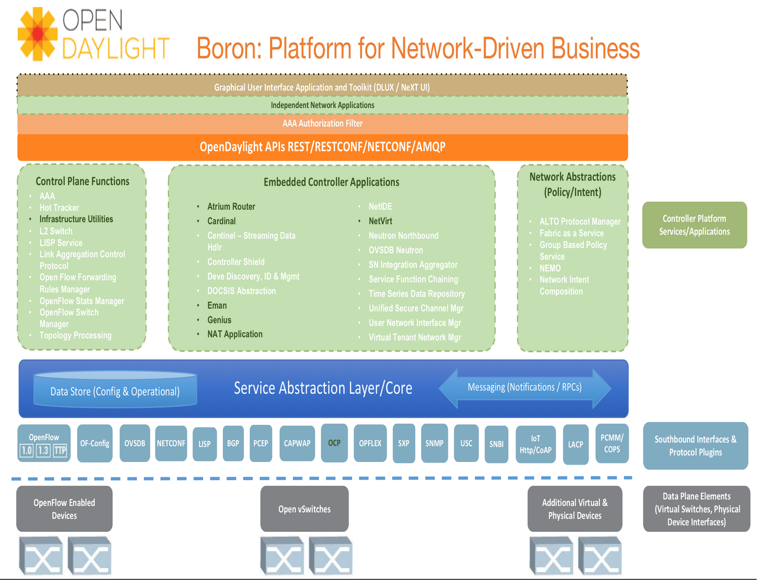
OpenDaylight: An opensource YANG-based model-driven system

Slide 24
An Operational View of OpenDaylight
Graphical User Interface Application and Toolkit (DLUX / NeXT UI)
Independent Network Applications
AAA Authorization Filter
OpenDaylight APIs
Control Plane Functions
Embedded Controller Applications
Network Abstractions (Policy/Intent)
Application
(Processing)
Model
Service Abstraction Layer/Core
API
Data Store (Config & Operational)
Messaging (Notifications / RPCs)
API
Standardized Southbound Interfaces & Protocol Plugins
Protocol Plugin
Model
Data Plane Elements (Virtual Switches, Physical Device Interfaces)
OpenFlow Enabled Devices
Open vSwitches
Additional Virtual & Physical Devices

Slide 25
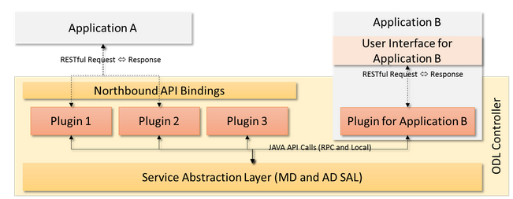
Writing ”Transformations” in ODL: two options Java or REST
Simplest way is to re-use RESTCONF interfaces exposed by existing plugins. Your application would not be “native” to the platform.
For a ”native” application, you would need to use the Java Open Service Gateway Interface (OSGi)
ODL team has done a great job on toolings available to help development process
Source: http://thenewstack.io/writing-opendaylight-applications/

Slide 26
Ontology and Machine learning

Slide 27
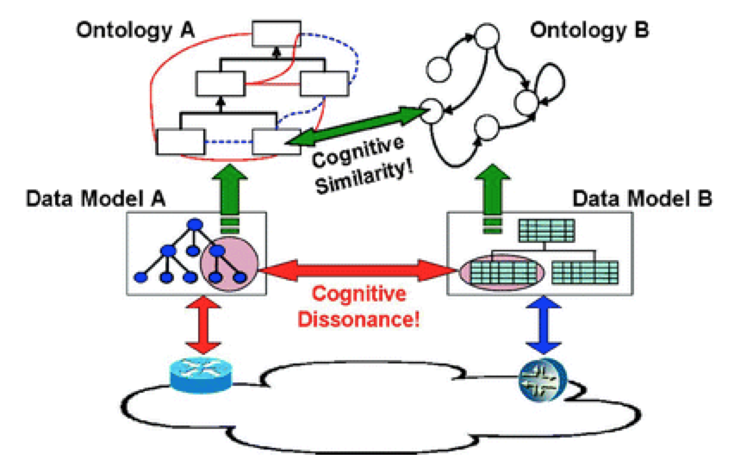
Ontology comes from “knowledge science” What kind of things models are…?
Source: Applied Ontology Engineering in Cloud Services, Networks and Management Systems.

Slide 28
Context Modeling A formal representation of context information
Source: Applied Ontology Engineering in Cloud Services, Networks and Management Systems.

Slide 29
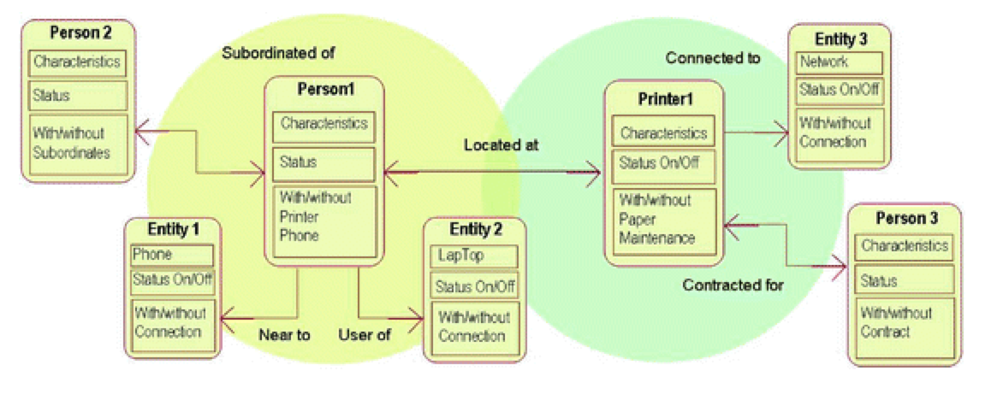
Entity Model and Relationships
Source: Applied Ontology Engineering in Cloud Services, Networks and Management Systems.

Slide 30
Machine Learning

Slide 31
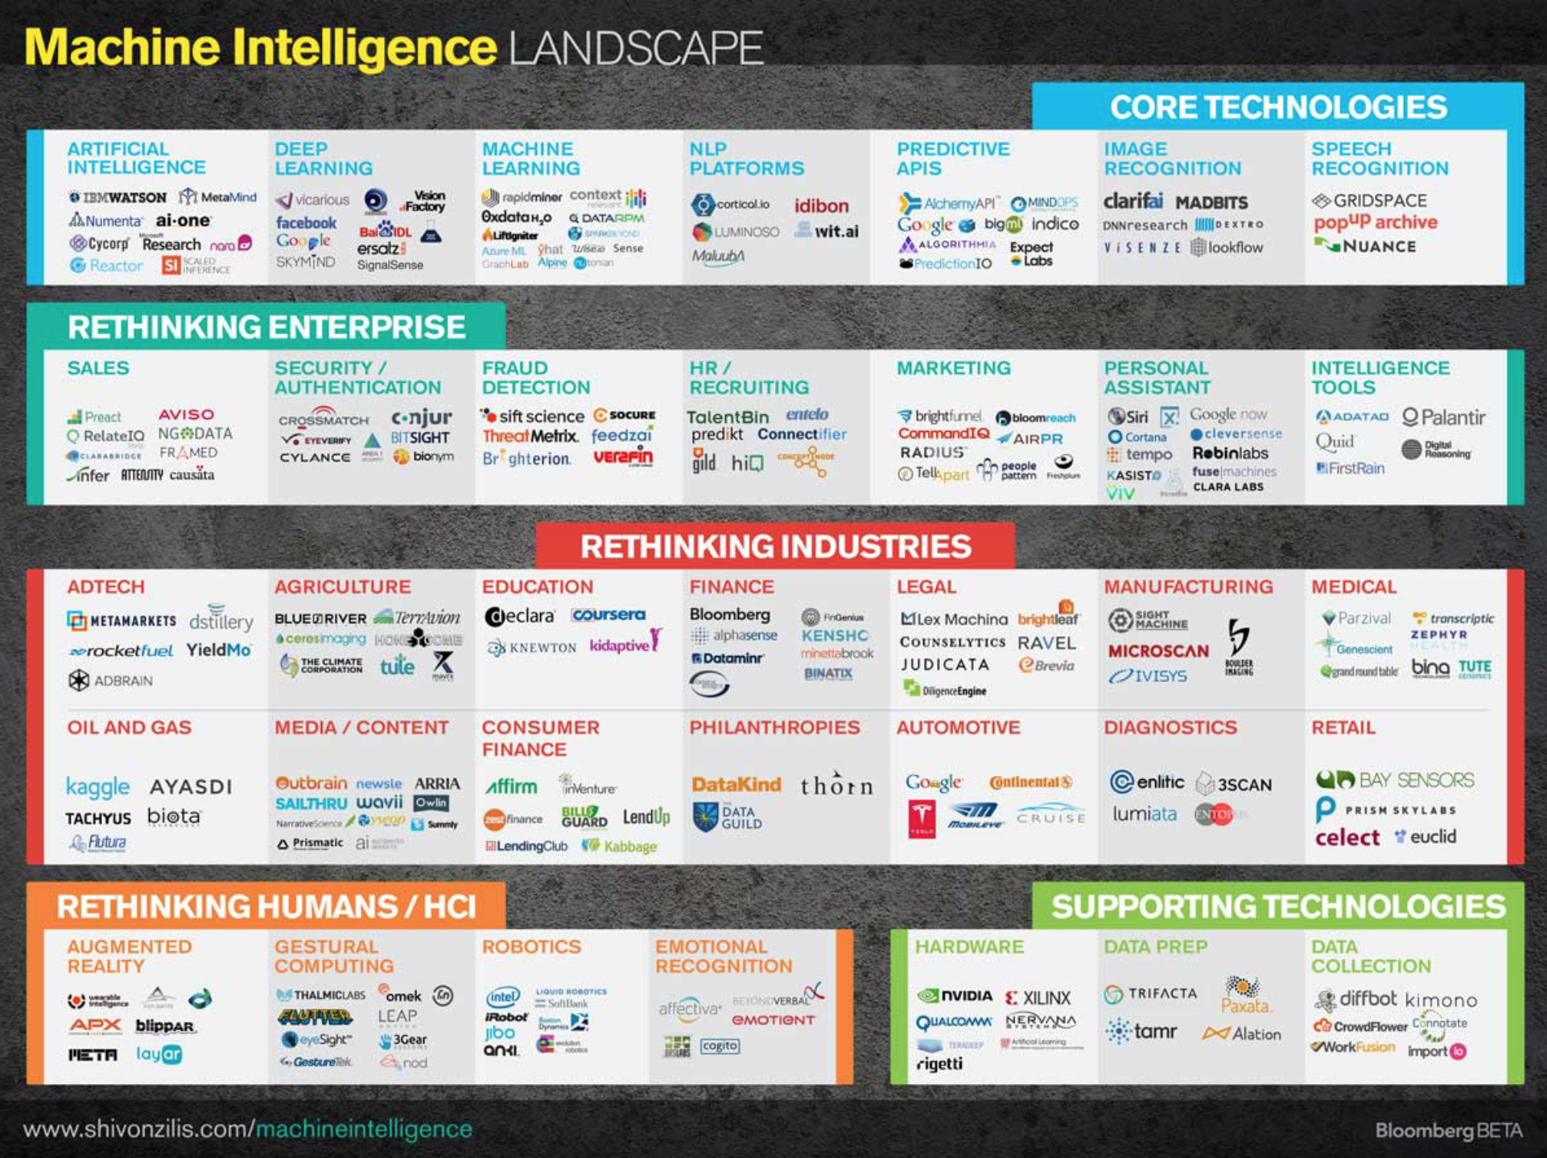
The New Buzz in the industry

Slide 32
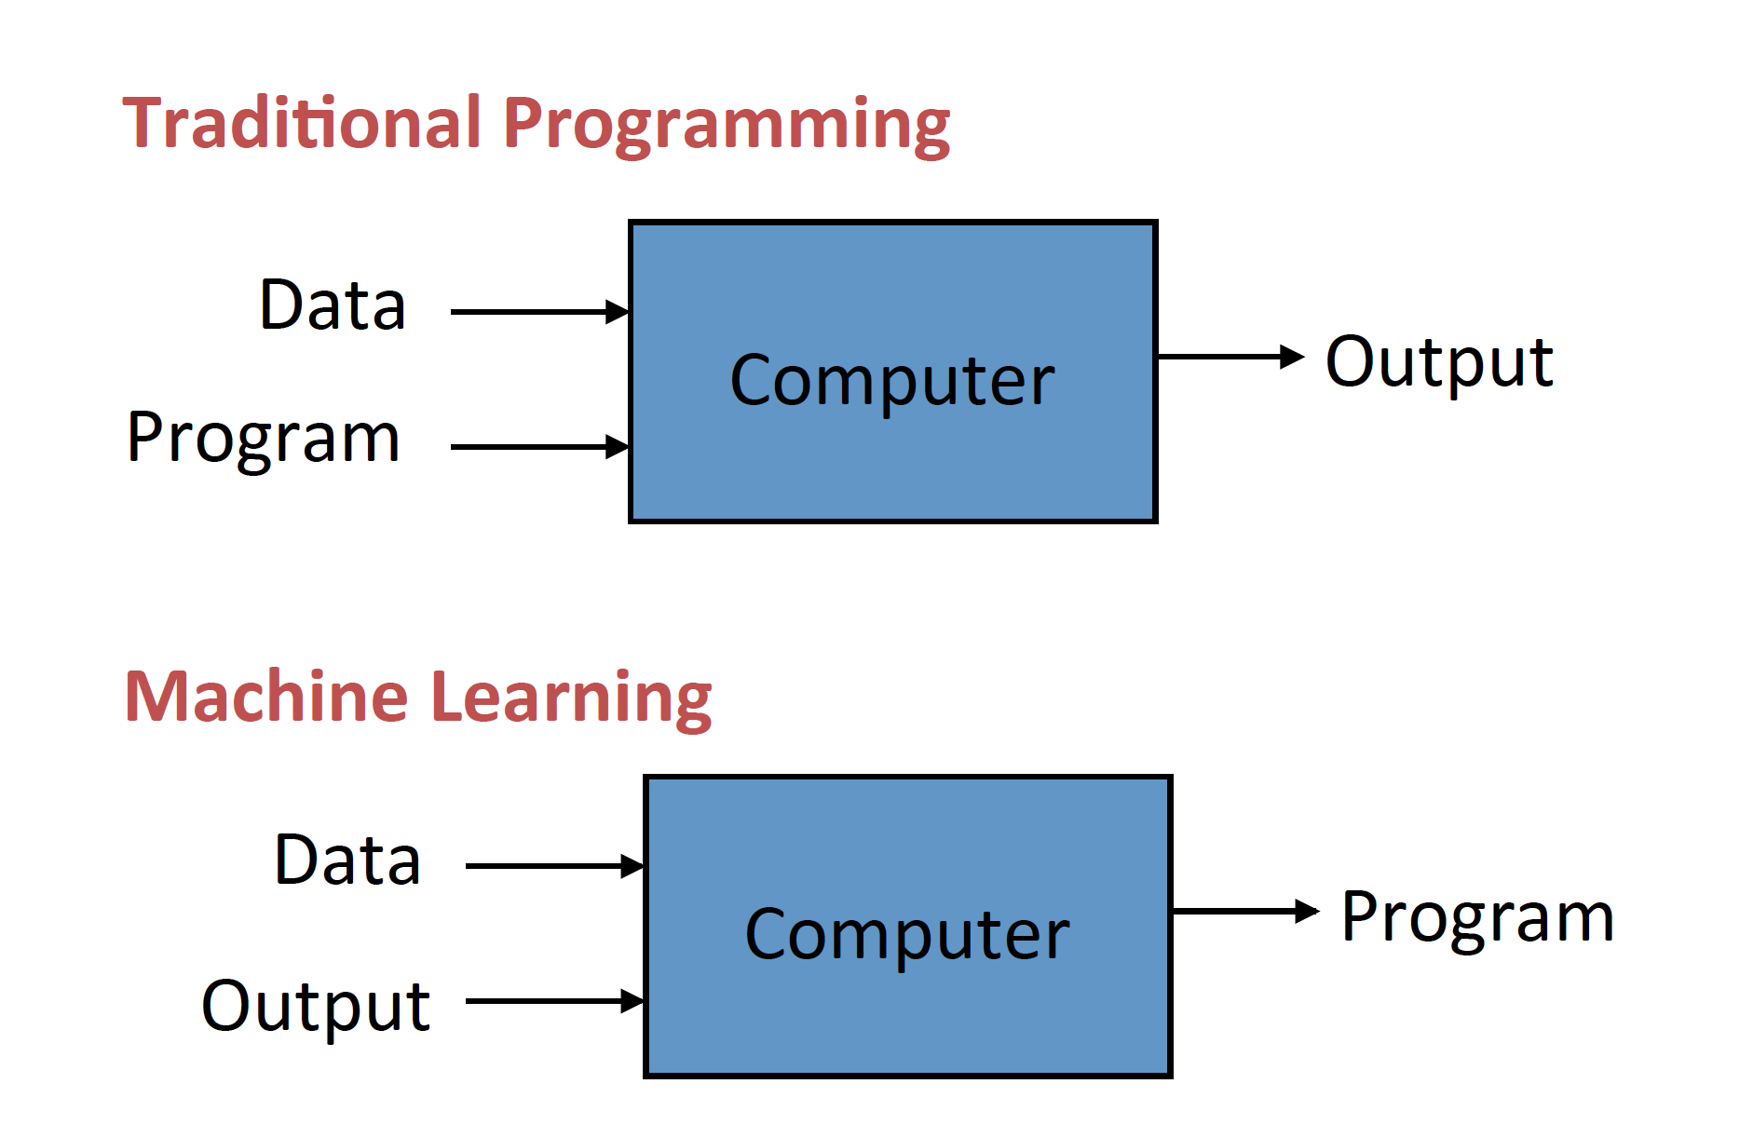
What is machine learning?

Slide 33
What would it mean for network services?
Inputs
Computer
Business Logic
Configs

Slide 34
Machine Learning use cases today in Telecom
Security:
Pattern recognition (DDoS detection)
Anomaly detection (new virus/trojans, etc.)
Mobile:
Self-Organized networks
BW optimization
In general using highly distributed solutions

